Slide 1


Effects of superfluidity-superconductivity and Landau quantization on neutron star magneto-thermal evolution
Peter Rau
Simons Collaboration on Extreme Electrodynamics of Compact Sources Postdoctoral Fellow, Columbia University
IReNA-INT Joint Meeting, December 12, 2024

Slide 2
Part 1: Superfluidity (SF) and superconductivity (SC) in neutron star magneto-thermal evolution

Slide 3
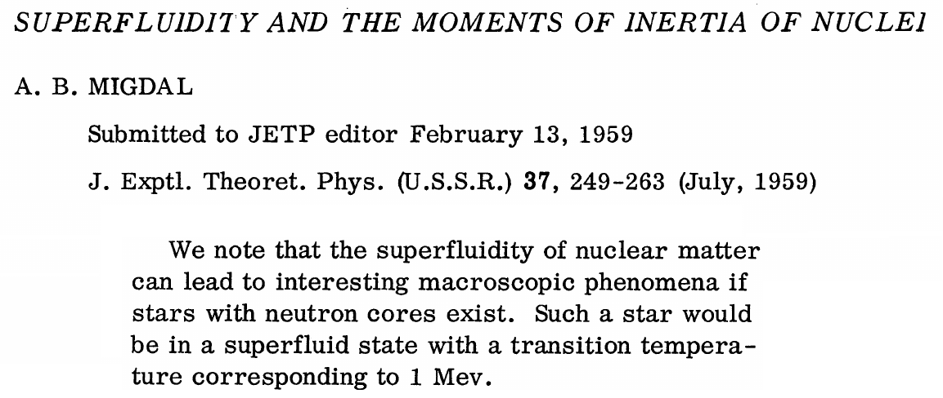
Superfluidity and superconductivity in neutron stars
Proposed by Migdal (1959) following application of nucleon Cooper pairing to explain gap in excitation energies of even and odd nuclei (Bohr, Mottelson and Pines 1958)

Slide 4
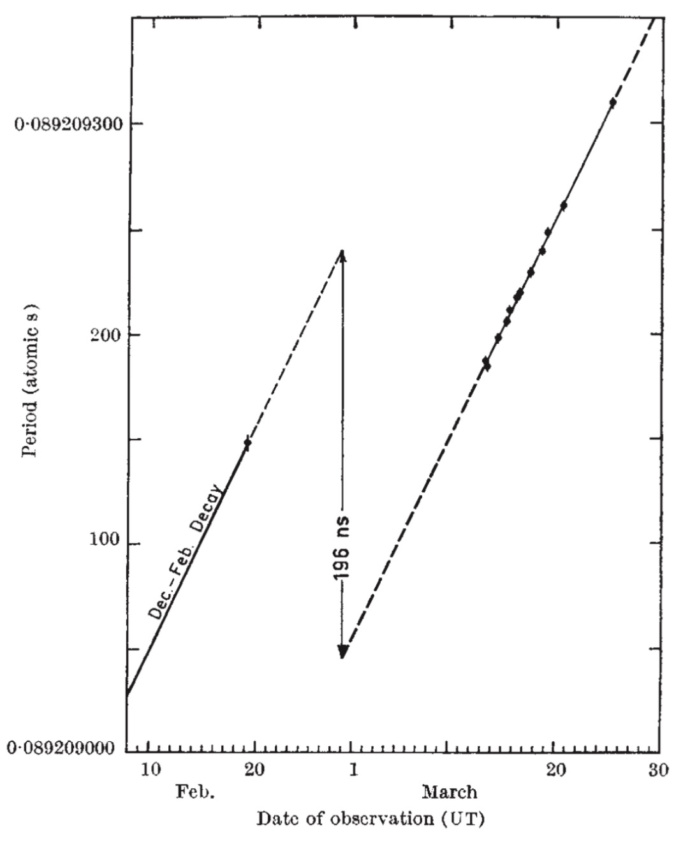
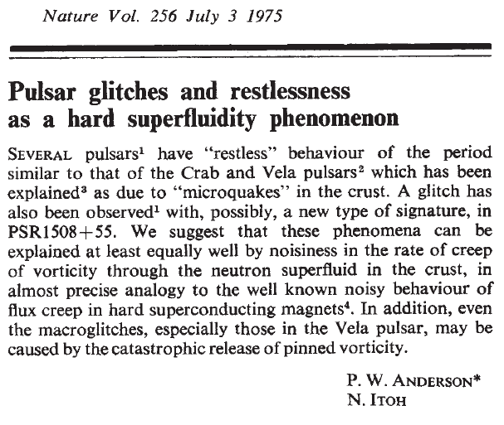
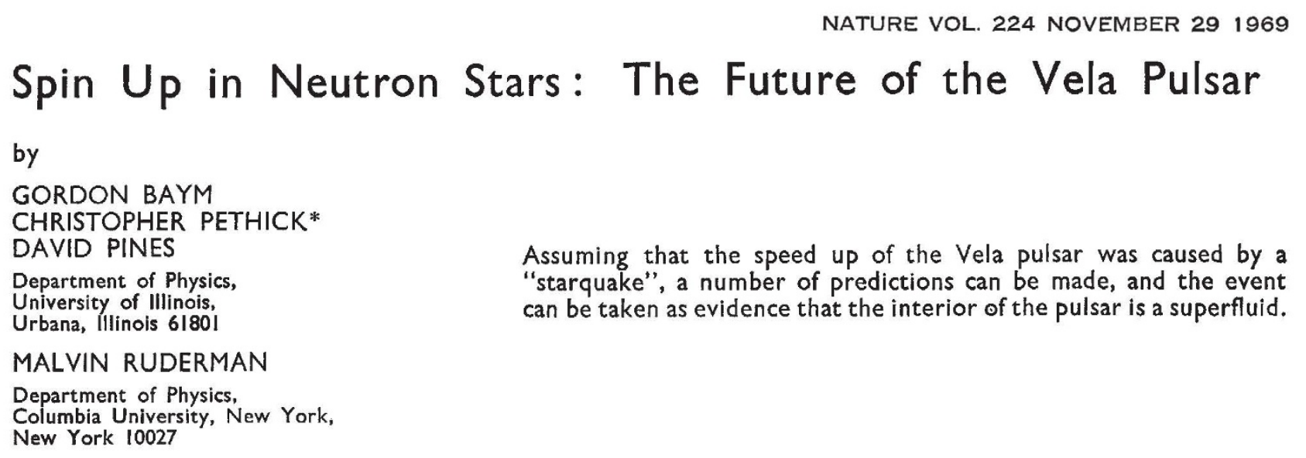
Confirmation: pulsar glitches (Baym, Pethick, Pines and Ruderman 1969; Anderson and Itoh 1975)
Radhakrishnan and Manchester 1969

Slide 5
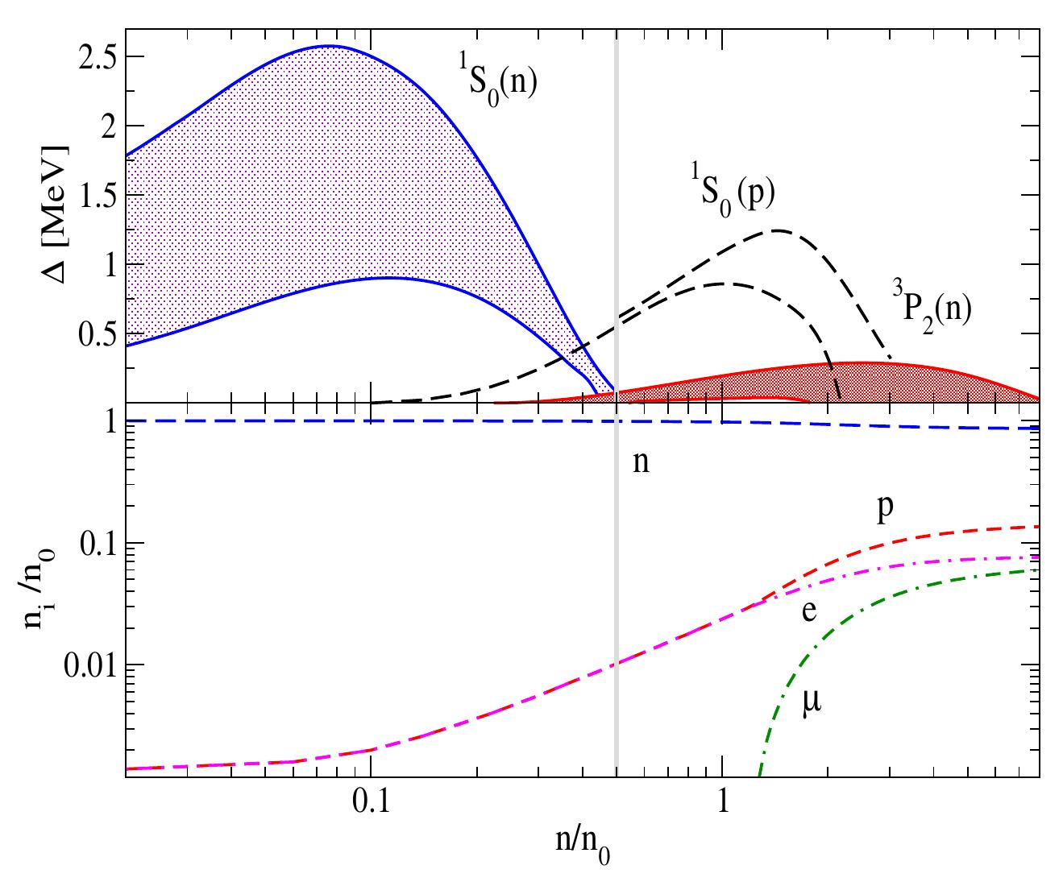
Nucleon Cooper pairing
Attractive nuclear interaction means neutrons, protons form Cooper pairs in inner crust/core of NS shortly after birth of star
Energy gaps ~100 keV to ~2 MeV
Sedrakian and Clark 2019

Slide 6
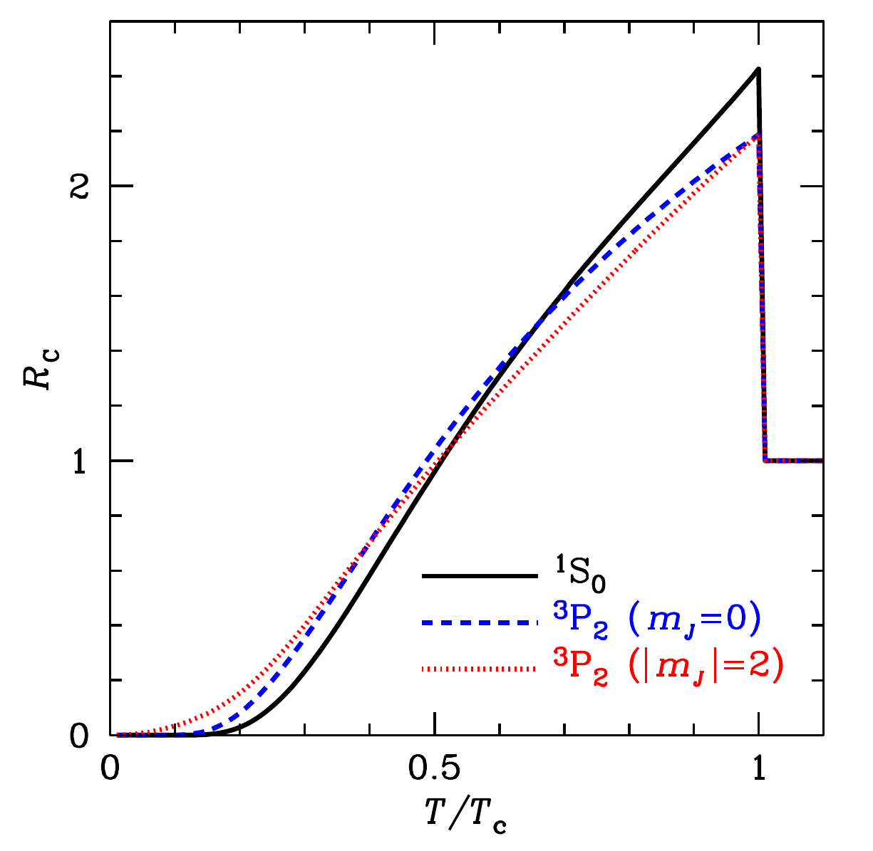
Heat capacity of SF-SC neutron star
Discontinuous “λ” transition: breaking Cooper pairs requires energy
(Yakovlev and Levenfish 1999)
Reduction in standard neutrino emissivities (MUrca, DUrca) treated similarly
Potekhin, Pons and Page 2015

Slide 7
Cooper pair breaking and formation (PBF)
Flowers et al. 1976, Voskresensky and Senatorov 1987
Collective effects reduce PBF emission for singlet pairing, but still effective for p-wave paired neutrons in core (e.g., Leinson and Pérez 2006)
Dominant process for

Slide 8
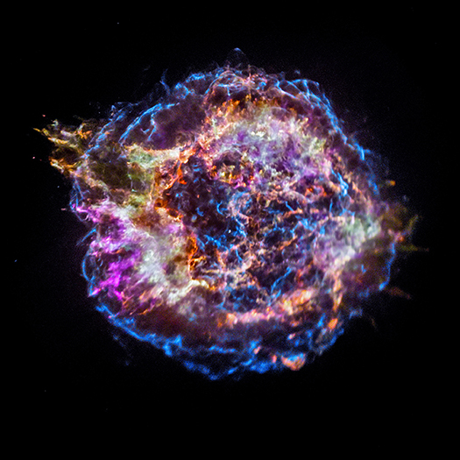
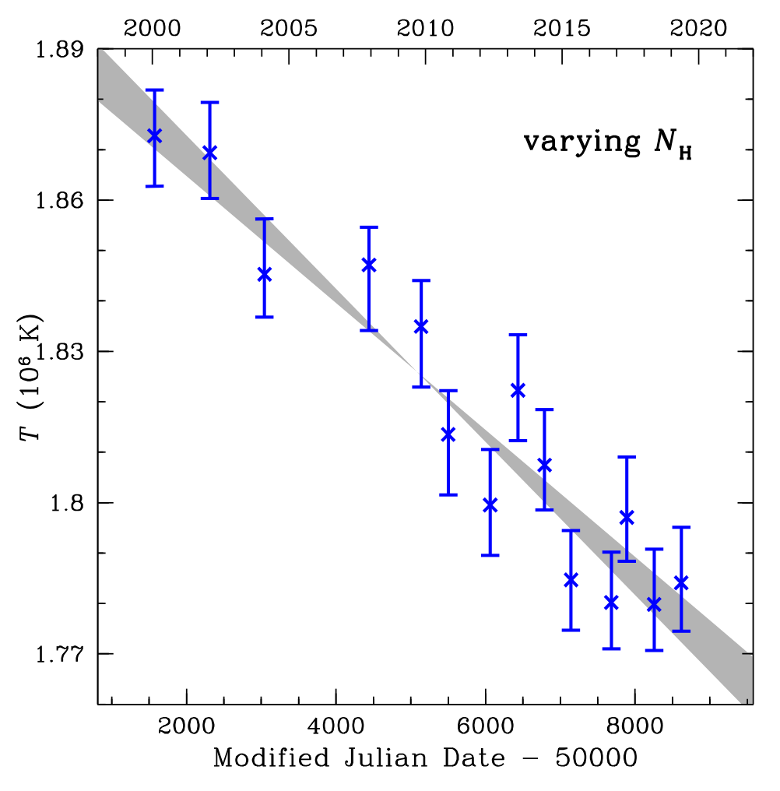
Dramatic demonstration of PBF cooling: enhanced cooling of Cas A (Page et al. 2011, Shternin et al. 2011,2021,2023, Ho et al. 2021)
temperature drop after 10 years- extremely fast!
NASA/CXC/SAO
Ho et al. 2021

Slide 9

SF-SC Neutron star thermal evolution
Heat conductivity in core very high, so isothermal for most of star’s life. In crust, dominated by electrons.
Key ingredients are neutrino emissivities- minimal cooling paradigm (Page et al. 2004, 2009)- and heat capacity
Solved with codes like NSCool (Page 2016), MATINS (Dehman et al. 2023, Ascenzi et al. 2024)
Verdict: Seemingly well understood

Slide 10
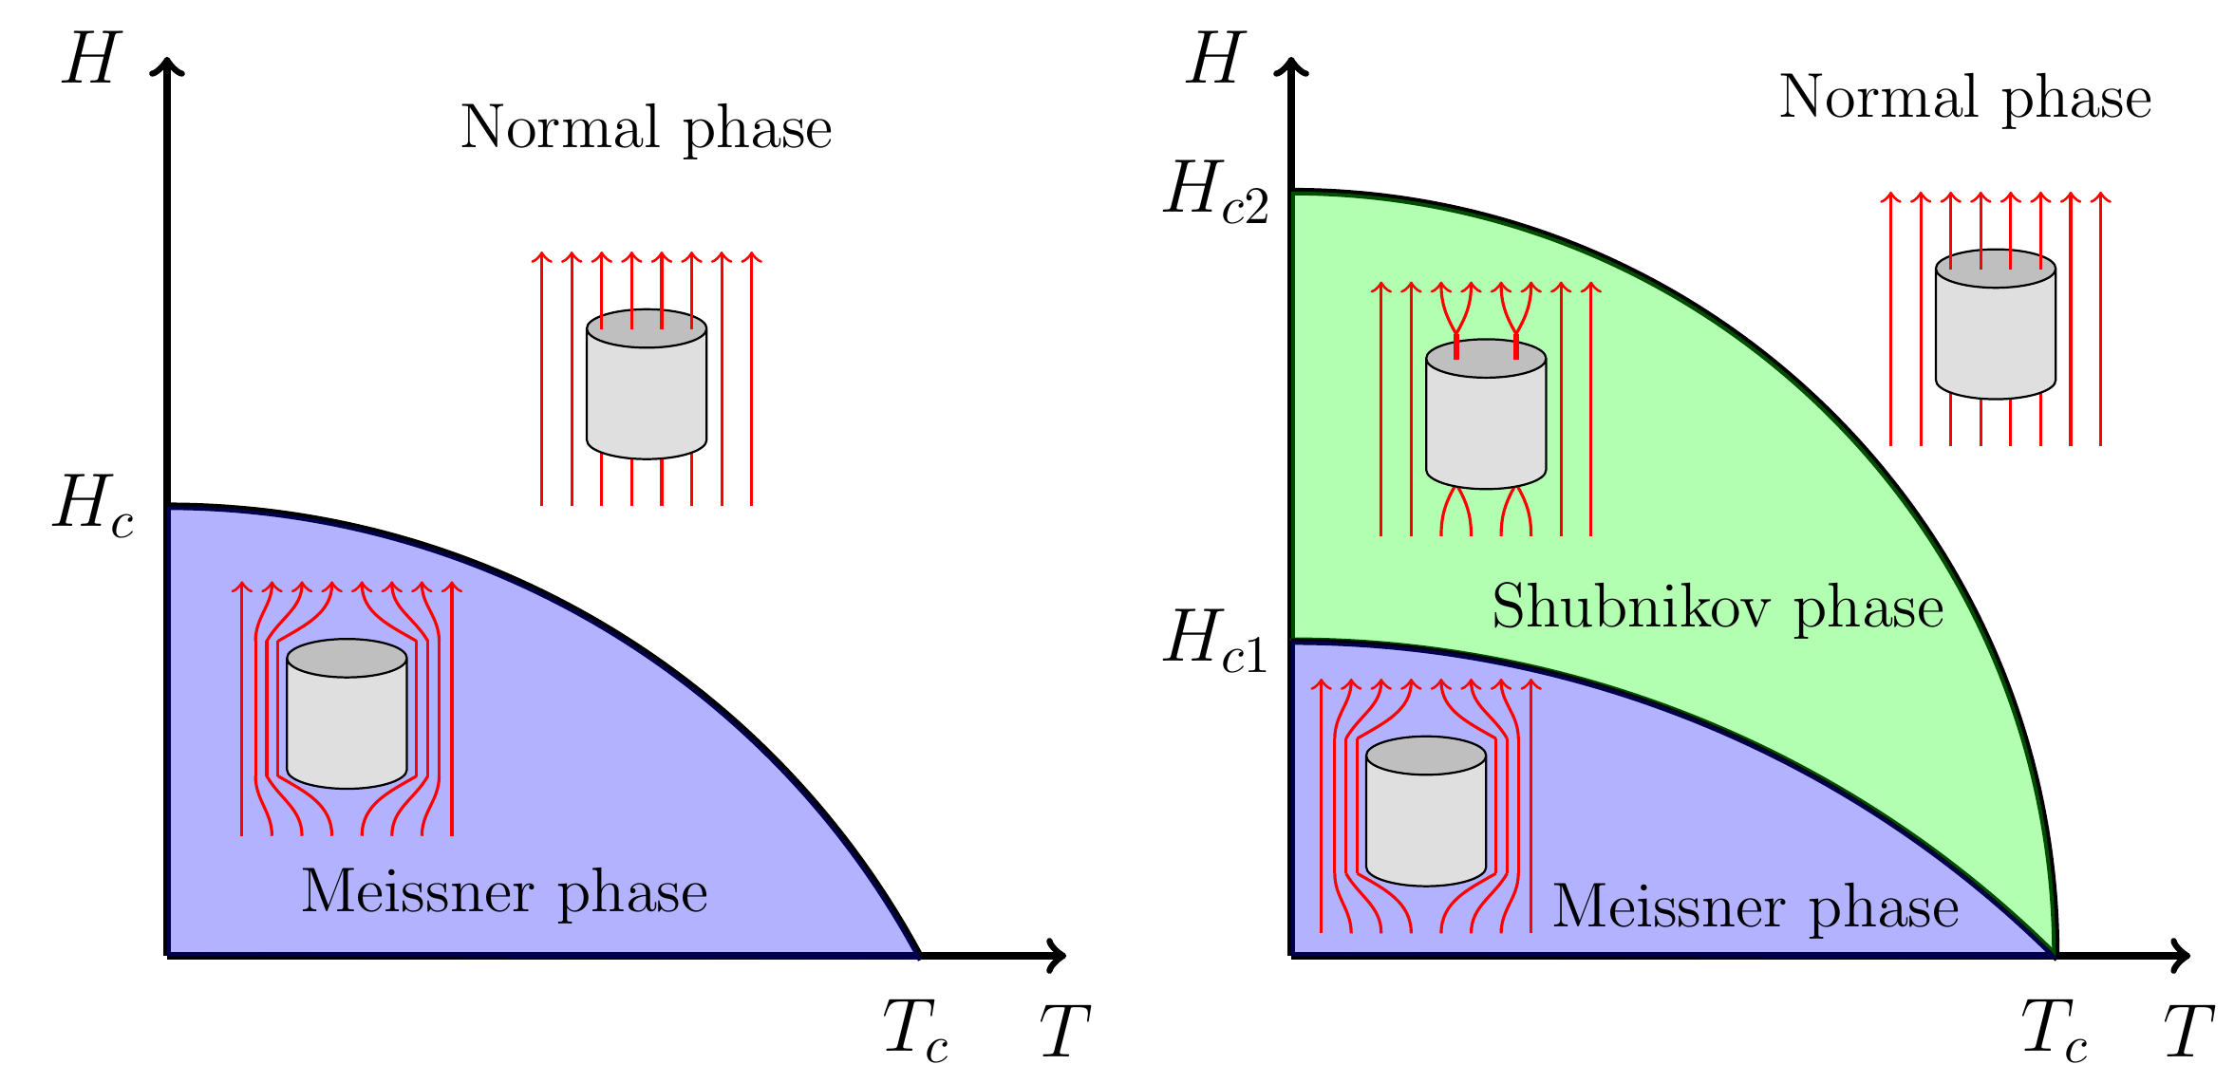
Classifying superconductors
Type-I
Type-II
London penetration depth
Coherence length

Slide 11
Magnetic fields in SC neutron stars
Protons are likely type-II in outer core, type-I in inner core (Glampedakis et al. 2011)
Most NS fields below , but still contain metastable quantized flux tubes
Meissner phase is stable below , but but only reached on Ohmic timescale > age of universe (Baym, Pethick and Pines 1969)

Slide 12
SF-SC neutron star magnetohydrodynamics
Many formulations of SF-SC neutron star MHD (e.g., Glampedakis et al. 2011, Graber et al. 2015, Gusakov and Dommes 2016, PR and Wasserman 2020)
Smaller number of magnetic field simulations (Elfritz et al. 2016, Passamonti et al. 2017, Bransgrove et al. 2018)

Slide 13
Magnetic evolution of SF-SC neutron star
Crust-core boundary condition: often incorrectly (for simplicity) assume type I SC core
Evolution of continuous magnetic field ≠ evolution of flux tube-confined field
Field should be advected with flux tubes:
Flux tube velocity
→ Need flux tube equation of motion to determine field evolution

Slide 14
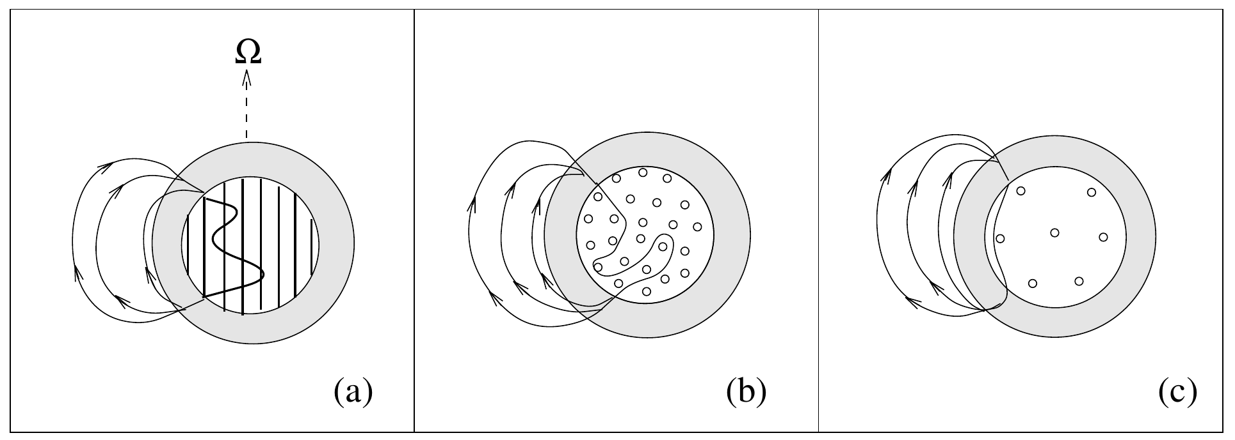
Flux tube-vortex line interaction
Pinning between entrainment-magnetized vortex line and flux tube arrays → coupling of (Srinivasan et al. 1990, Ruderman et al. 1998)
Vortex lines cut through flux tubes if they move faster (Ruderman et al. 1998, Jones 2006)
Modeled in e.g., Sourie and Chamel 2020, 2021, PR and Wasserman 2020
Ruderman, Zhu and Chen 1998

Slide 15
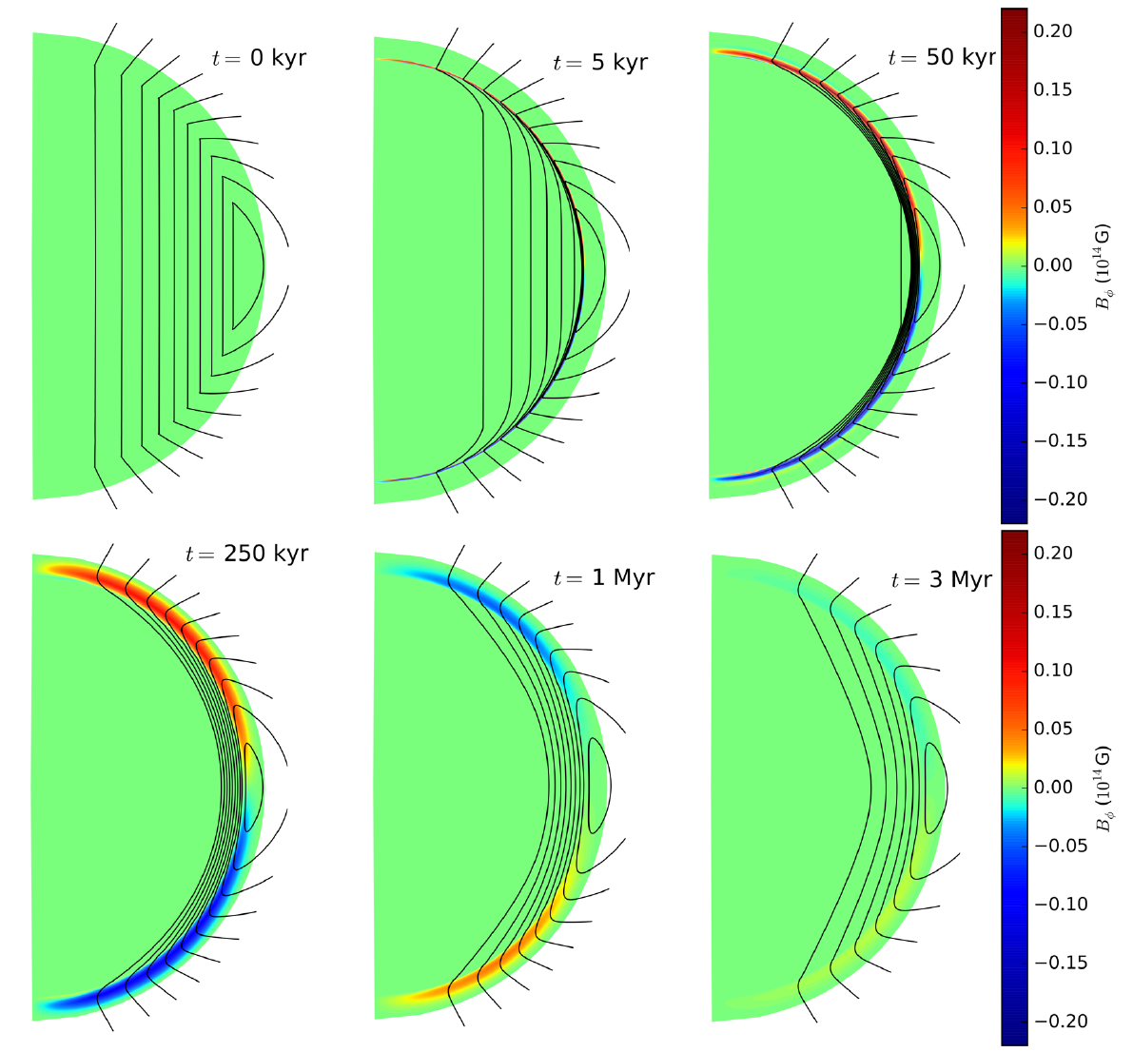
Flux tube expulsion
Force balance equation on proton flux tubes determines how quickly flux is expelled from SC core
Fast expulsion: (Jones 2006, Bransgrove et al. 2018)
Bransgrove, Levin and Beloborodov 2018

Slide 16

Slow expulsion: (Graber et al. 2015, Elfritz et al. 2016)
Gusakov 2019: form of EOM used in these studies was wrong, but time scale ~correct
Assumption of screening of electric field generated by moving flux tubes by electrons not always true (Kobyakov 2023): rethinking of Gusakov 2019 result
Verdict: Needs improvement

Slide 17
Select recent developments in SF-SC neutron stars
-paired neutrons in inner crust can become gapless due to a superflow exceeding Landau critical velocity→ no exponential suppression of heat capacity, consistent with LMXB cooling (Allard and Chamel 2021, 2023, 2024)
Kohn-Luttinger effect can modify p-wave neutron pairing gap ~10 keV-10 MeV (Kumamoto and Reddy 2024)

Slide 18
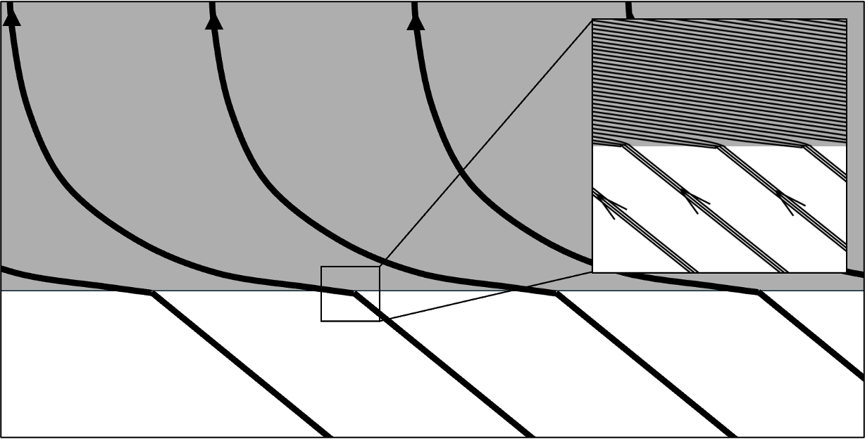
Giant Hall waves in pulsar crusts (Bransgrove, Levin and Beloborodov 2024)
Maxwell stress in SC is (Easson and Pethick 1977, Akgün and Wasserman 2008)
Continuity of tangential stress → amplification of horizontal in crust by factor

Slide 19
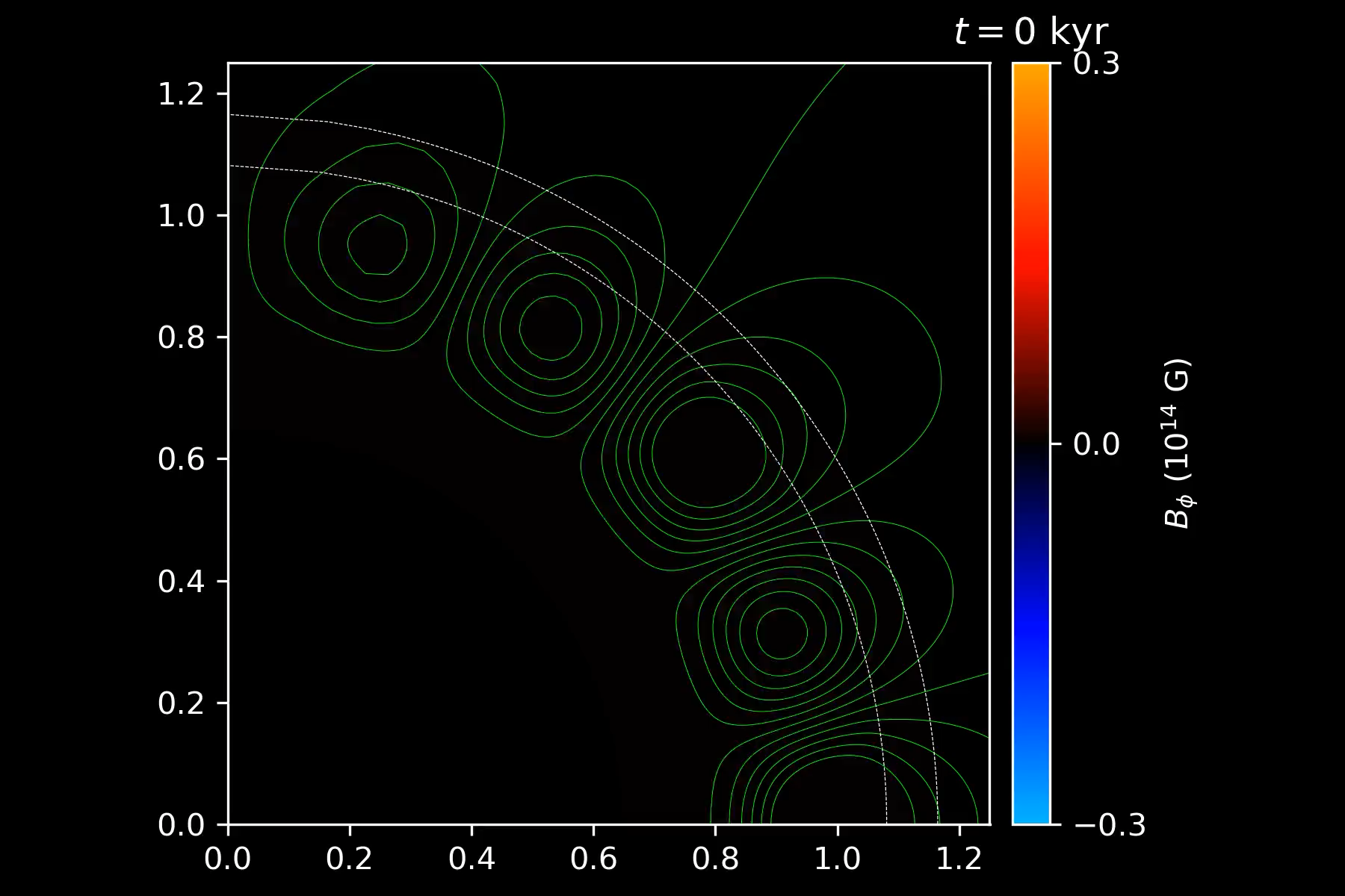
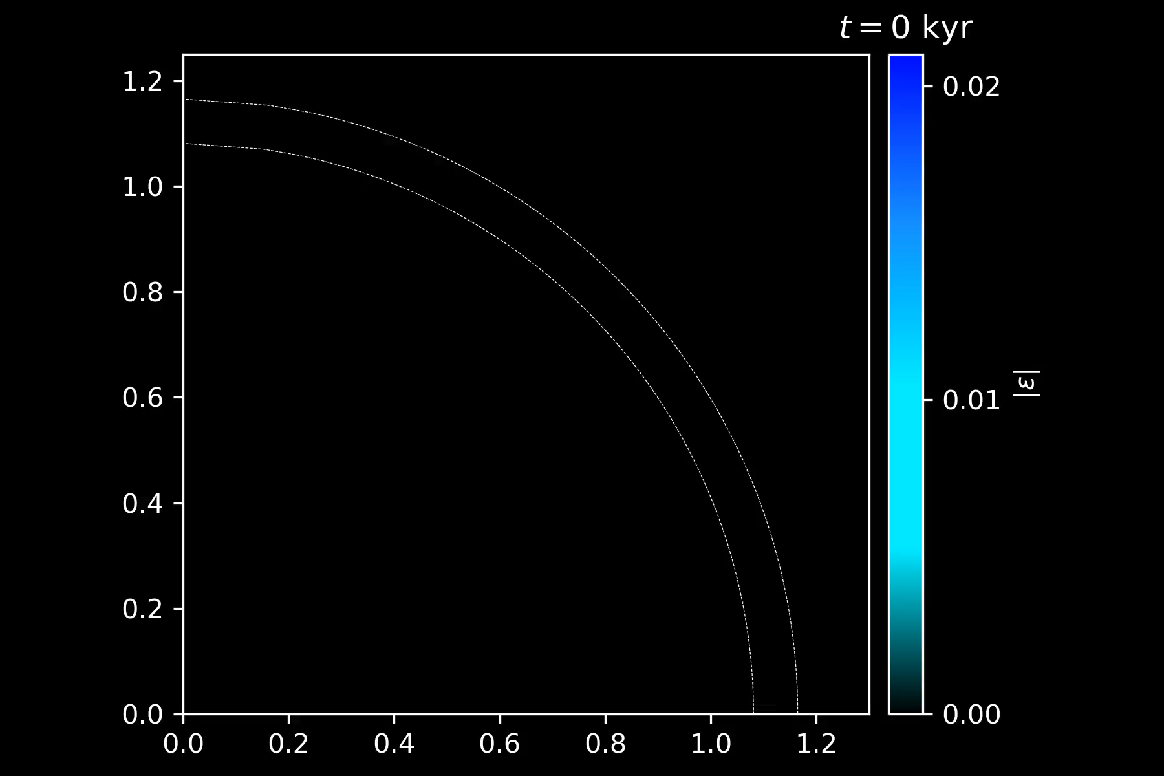
Transition to SC launches large amplitude Hall waves in crust which can exceed its breaking strain, triggering star quakes and glitches

Slide 20
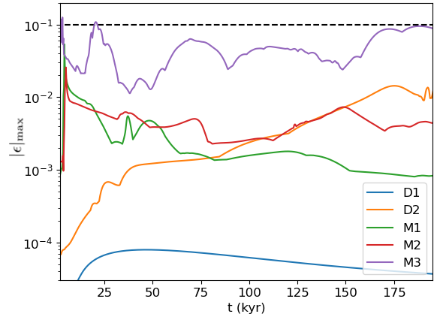
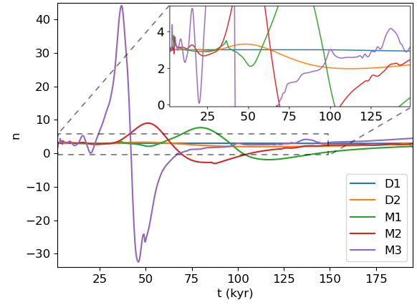
Hall waves couple to magnetosphere, produce anomalous braking indices

Slide 21
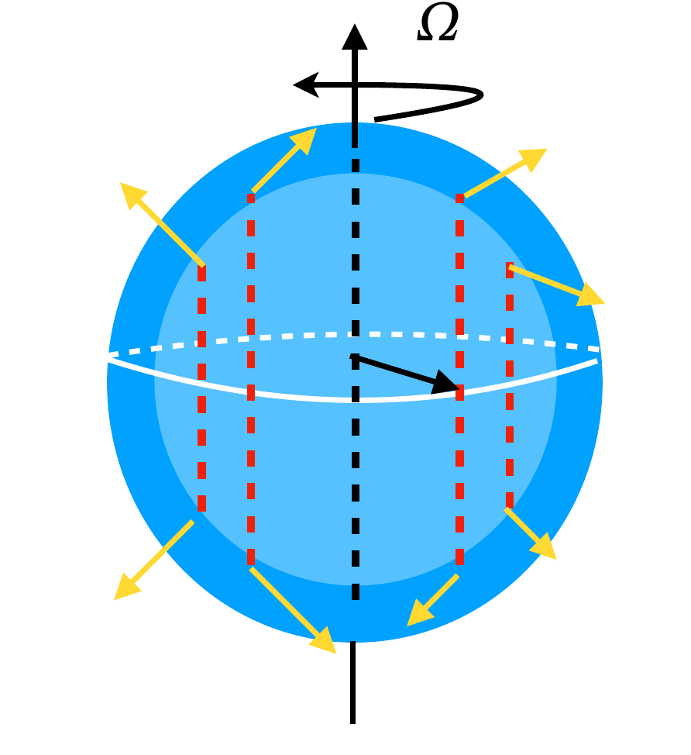
Josephson effects in neutron stars
(Sedrakian and PR 2024)
s-p neutron SF interface acts as Josephson junction
Neutron vortex lines move outward as star spins down → AC Josephson current driven by pinned flux tubes moving across interface → late-time heating ~100× strength of Ohmic dissipation

Slide 22
Part 2: Landau quantization (LQ) & neutron star magneto-thermal evolution

Slide 23
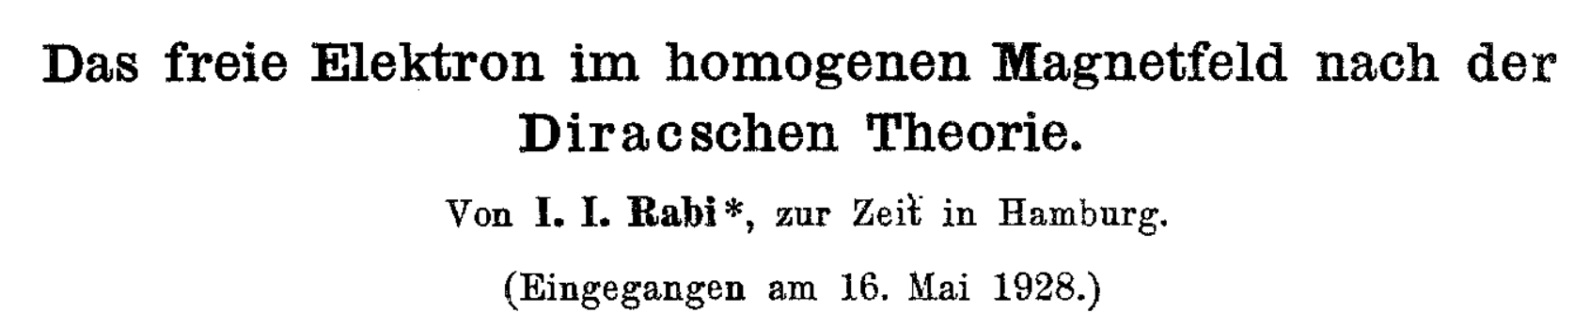
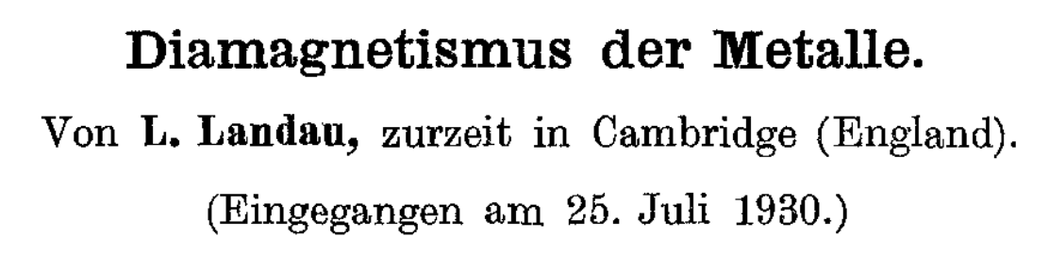
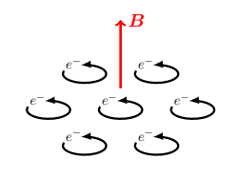
(Rabi)-Landau quantization
Quantization of fermion momentum in plane
Gives field-dependence to thermodynamic, transport properties- well known in condensed matter physics

Slide 24
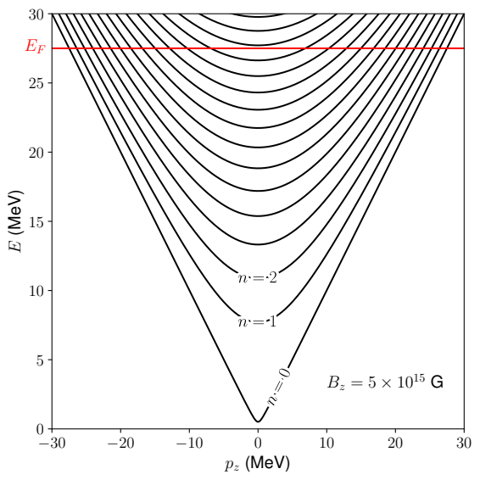
Relativistic electron Landau level energies are
with degeneracy factor
Electrons fill Landau levels up to

Slide 25
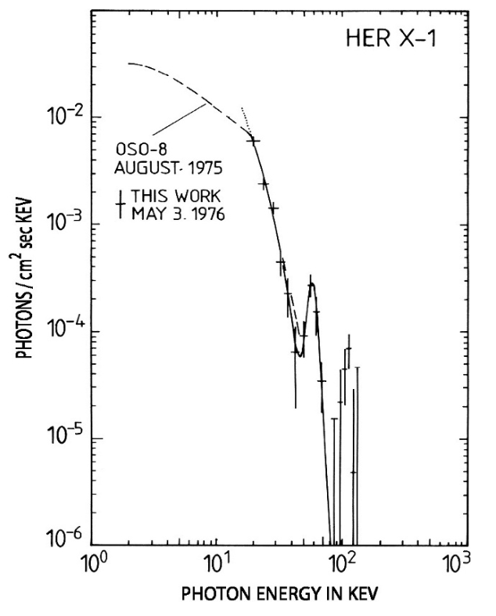
LQ in/around neutron stars
Manifestations of LQ in astrophysics considered since at least the 1960s
Transitions between cyclotron lines as absorption lines in X-ray spectra- direct measurement of exterior (Staubert et al. 2019)
LMXB Her X-1 has cyclotron absorption line at
Trümper et al. 1978
Notes:
Around 35 compact X-ray sources with
Absorption line because hot, radiating plasma around accreting NS is optically thick, has low emissivity

Slide 26
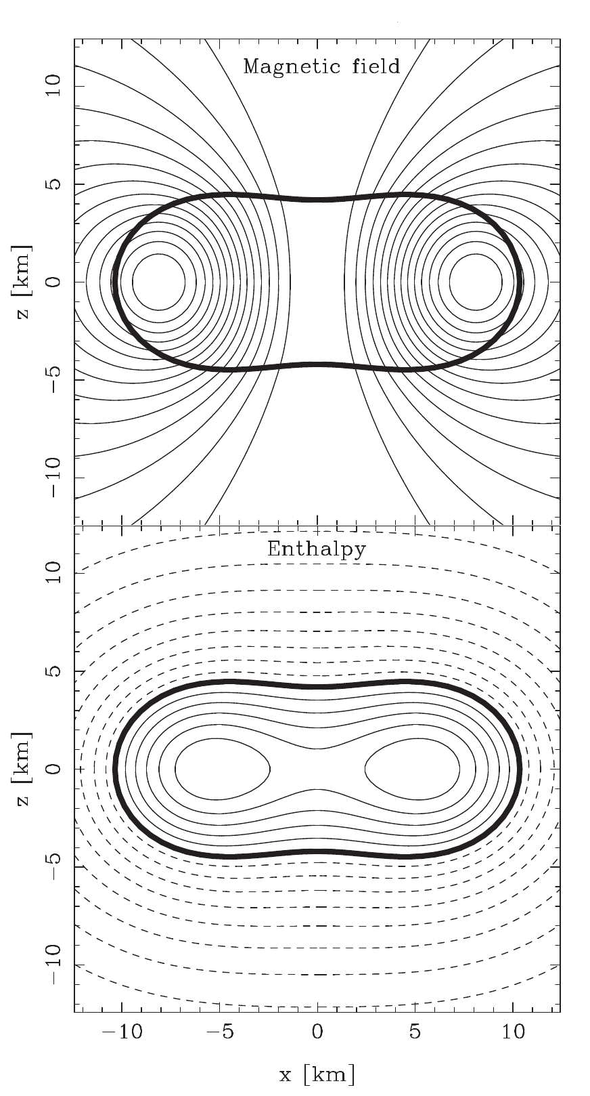
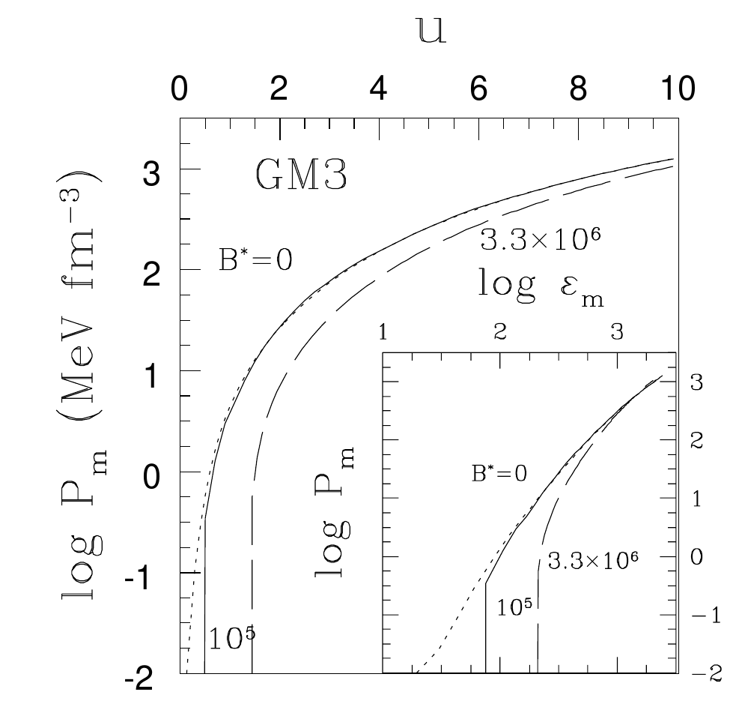
LQ and the equation of state
Pressure becomes
Negligible modification to core EOS for (e.g. Broderick et al. 2000), by which point the star is toroidal (Chatterjee et al. 2015)!
Broderick et al. 2000
Chatterjee et al. 2015

Slide 27
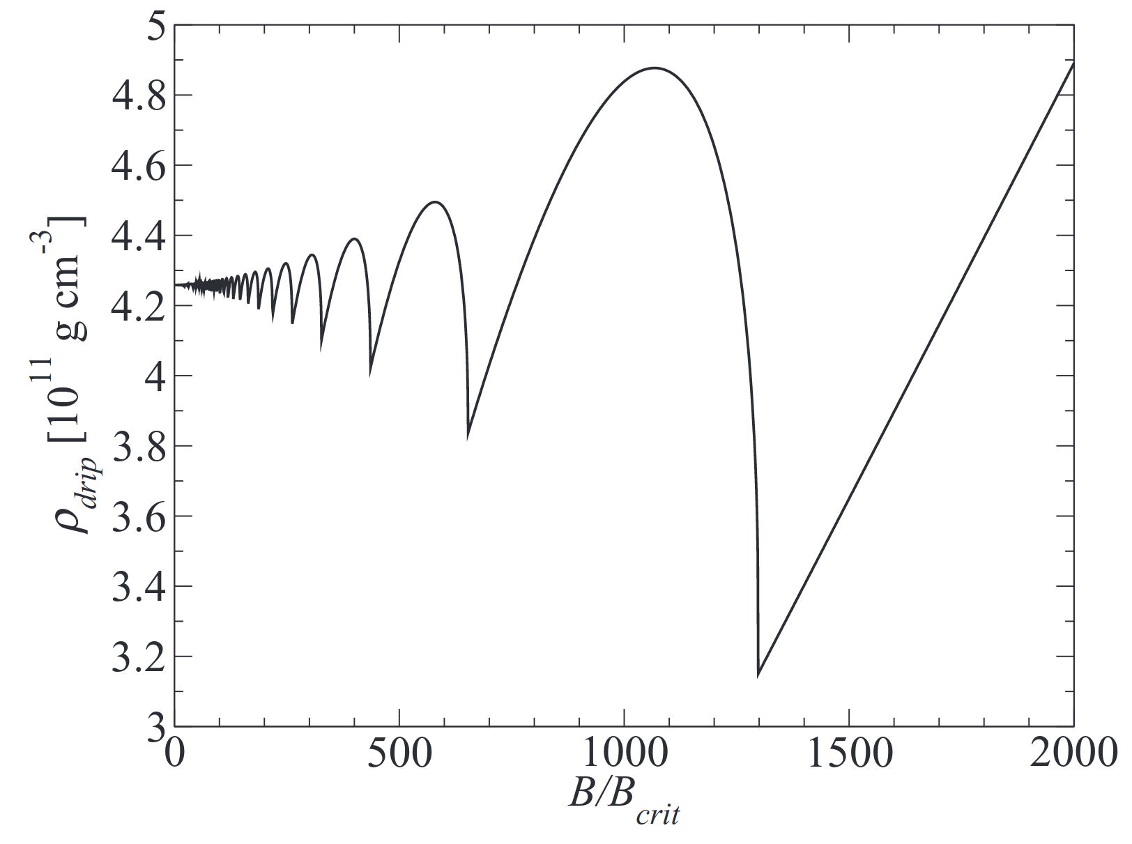
In crust LQ changes nuclear composition (Chamel and Stoyanov 2020), neutron drip line (Chamel et al. 2015)
Chamel et al. 2015

Slide 28
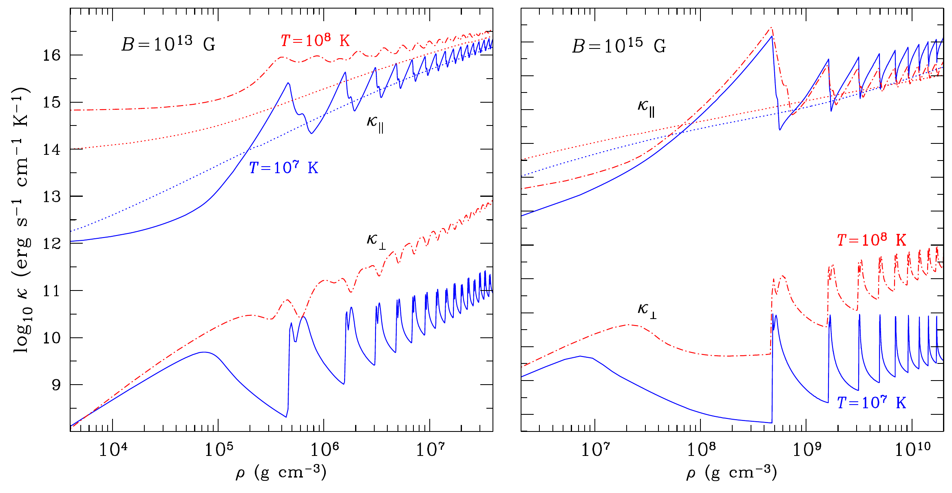
LQ and transport
Transport coefficients undergo Shubnikov-de Haas (SdH) oscillations (Canuto and Chiu 1970, Kaminker and Yakovlev 1981, Hernquist 1984, Potekhin 1999)
Scattering suppressed by Landau quantization
Potekhin, Pons and Page 2015
Notes:
Peaks occur when most phase space left to fill (low filling factor of highest-occupied Landau levels), reach troughs when completely filled.
Peaks occur where Landau levels are exactly filled
In plot, dashed lines are non-magnetic conductivities (no classical modification to conductivity either)

Slide 29
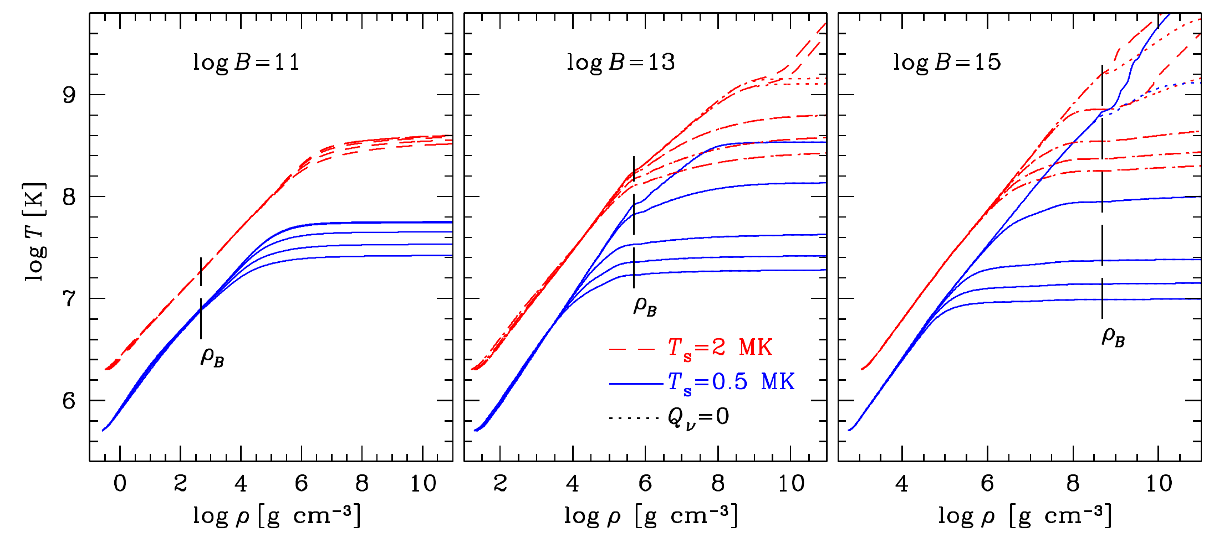
Effects most important at low and → changes to heat blanketing envelope (e.g, Hernquist 1985, van Riper 1988, Potekhin and Yakovlev 2001)
Beznogov, Potekhin and Yakovlev 2021

Slide 30
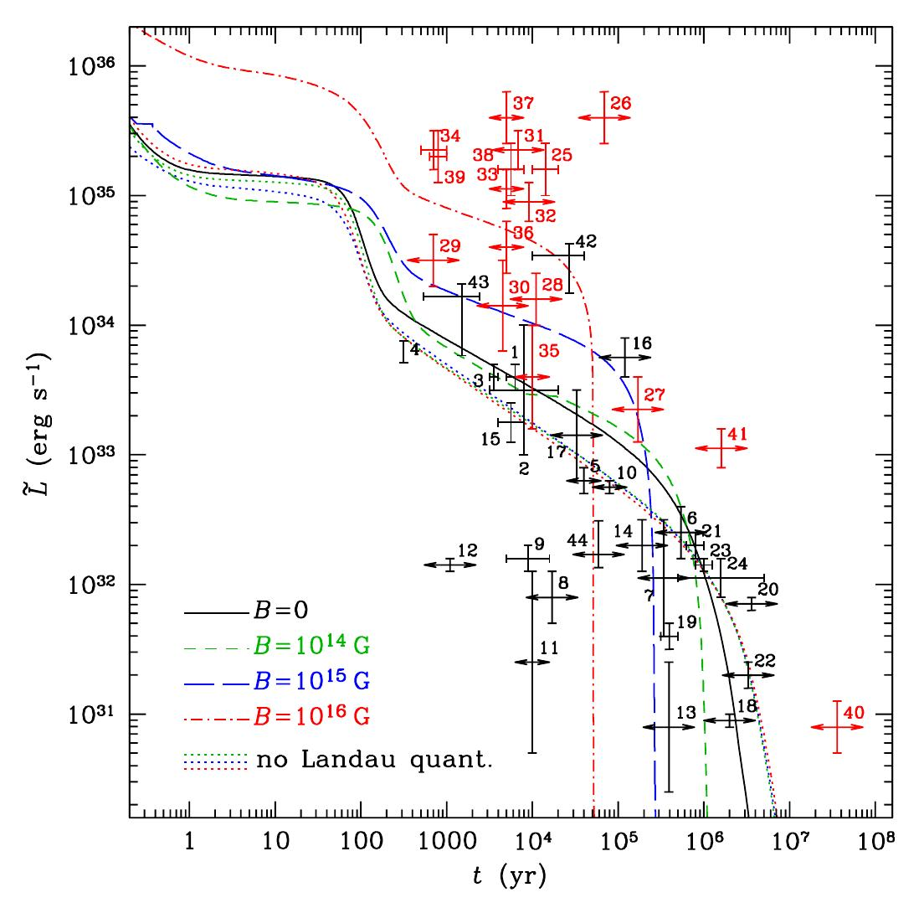
LQ effects usually neglected in magneto-thermal simulations
Exception: Potekhin and Chabrier 2018, but only include LQ effects on
EOS (small)
Thermal conductivity and opacities
Magnetic condensation of surface (Ruderman 1971, Lai and Salpeter 1997, Medin and Lai 2006, 2007)
Assumed fixed tangled field, no heating
Potekhin and Chabrier 2018
Notes:
Increased luminosity with LQ because of enhanced thermal conductivity parallel to field lines

Slide 31
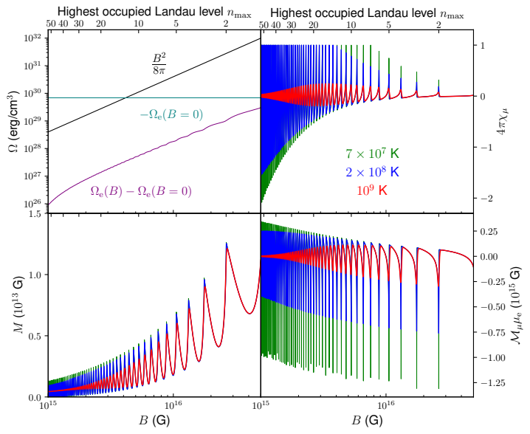
LQ and magnetization
Magnetization and magnetic susceptibility undergo de Haas-van Alphen (dHvA) oscillations
Amplitude of dHvA oscillations of

Slide 32
Pauli paramagnetism plus Landau diamagnetism
de Haas-van Alphen oscillations: “periodic” in
Thermal suppression factor
Notes:
Pauli paramagnetism- intrinsic magnetization of electron spin
Landau diamagnetism- magnetization of orbital motion
More generally, PdHvA is inversely proportional to the area of the Fermi surface, which is used in condensed matter physics

Slide 33
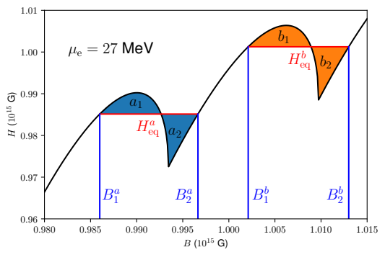
When
magnetic domains form (Blandford and Hernquist 1982, Suh and Mathews 2011, PR and Wasserman 2021, 2023)
PR and Wasserman 2023

Slide 34
LQ-enhanced heating in neutron star crusts (PR and Wasserman 2024)
Due to magnetization, current density becomes
Large-amplitude dHvA oscillations can generate short-length scale perturbations in , enhancing its dissipation (and hence Joule heating)
Enhancement of current

Slide 35
Most important in magnetar crusts and in moderate-to-weakly quantized regime
Solve electron MHD (Ohmic dissipation + Hall drift) with dHvA in
Problem: length scale of dHvA oscillations is
→ Need ~ few m resolution!

Slide 36
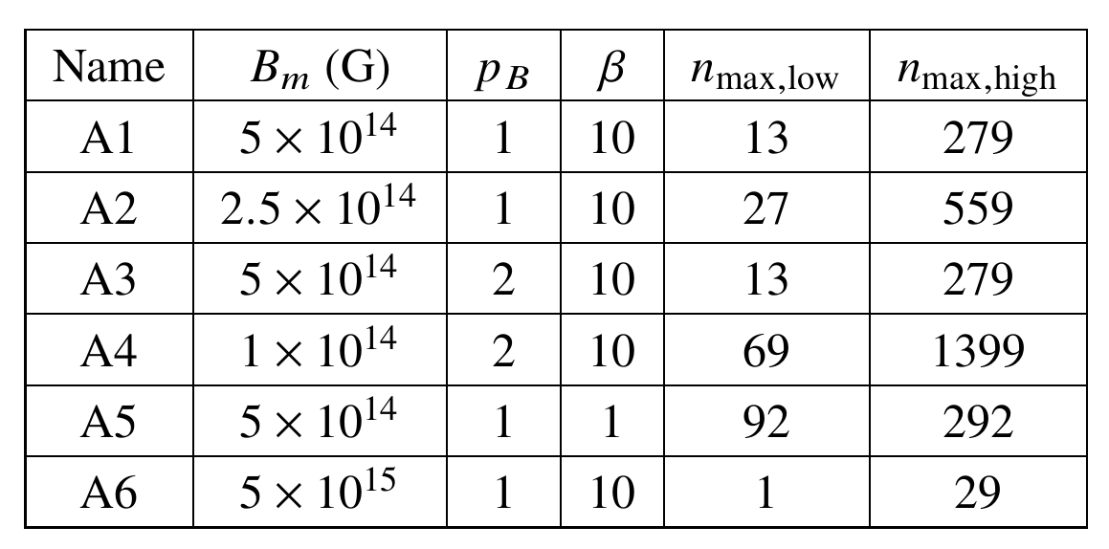
Simulations
Full crust simulation very expensive:
Computing at every time step increases computational cost by order of magnitude
High resolution needed to resolve dHvA oscillations
Proof-of-concept: periodic domain in 2.5D, with classical, isotropic conductivity

Slide 37
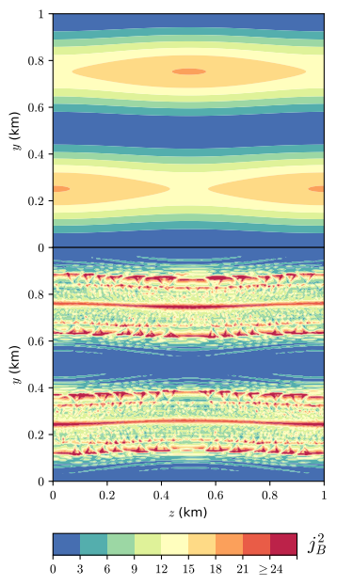
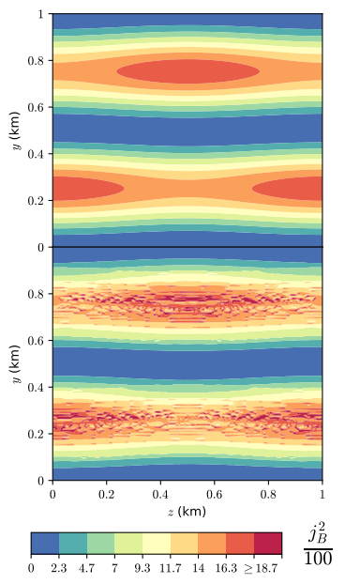
Ohmic decay-only simulations
Left: A1
Right: A6
Shows that LQ, dHvA oscillations are more important for moderate-to weakly-quantizing fields
No LQ
LQ

Slide 38
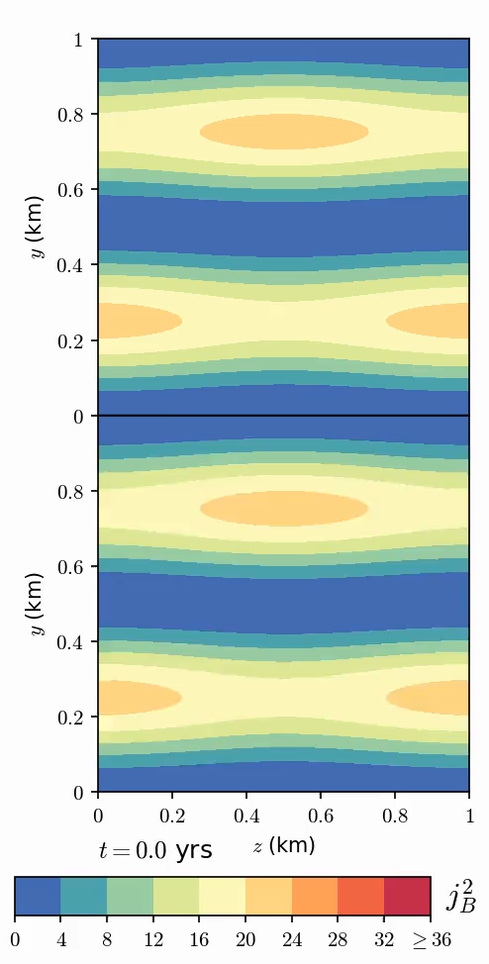
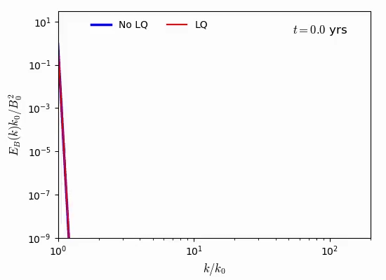
Hall-Ohm simulations
No LQ
Configuration A1
LQ
dHvA oscillations boost the Hall effect’s enhancement of Ohmic dissipation

Slide 39
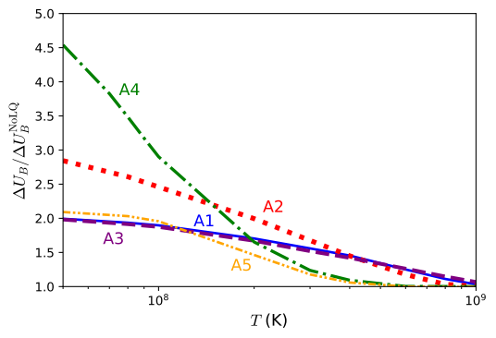
Effect of temperature
Dissipation increases with decreasing , especially for weakly quantizing fields

Slide 40
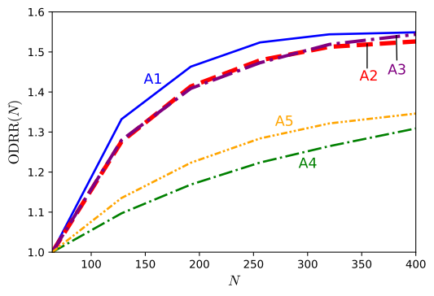
Effect of resolution
Increasing dissipation with resolution, but converges above

Slide 41
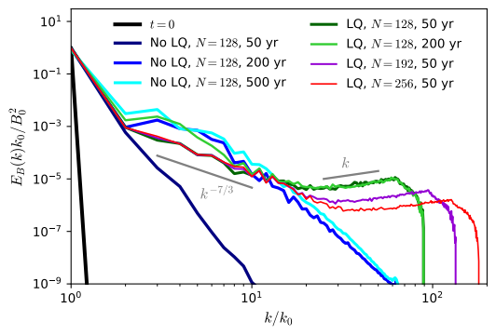
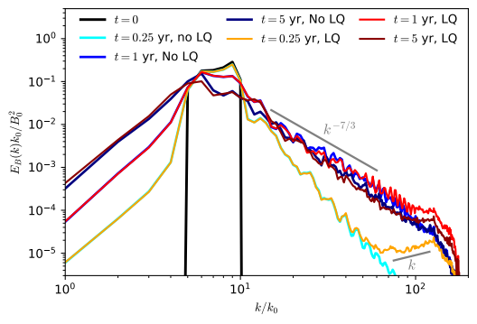
Magnetic energy spectrum
Large-scale initial field (A1)
Turbulent initial field
Standard Hall cascade scaling (Biskamp et al 1996, 1999, Ng et al 2003, Cho and Lazarian 2004)
For turbulent initial field, dHvA effects quickly overwhelmed by Hall cascade

Slide 42
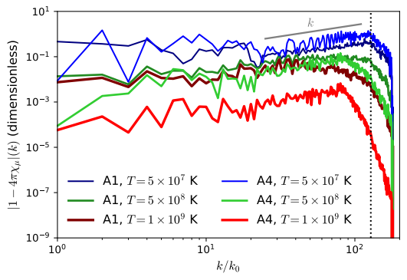
Why does the “plateau” scale as ?
With sufficient resolution, would resolve physical cutoff

Slide 43
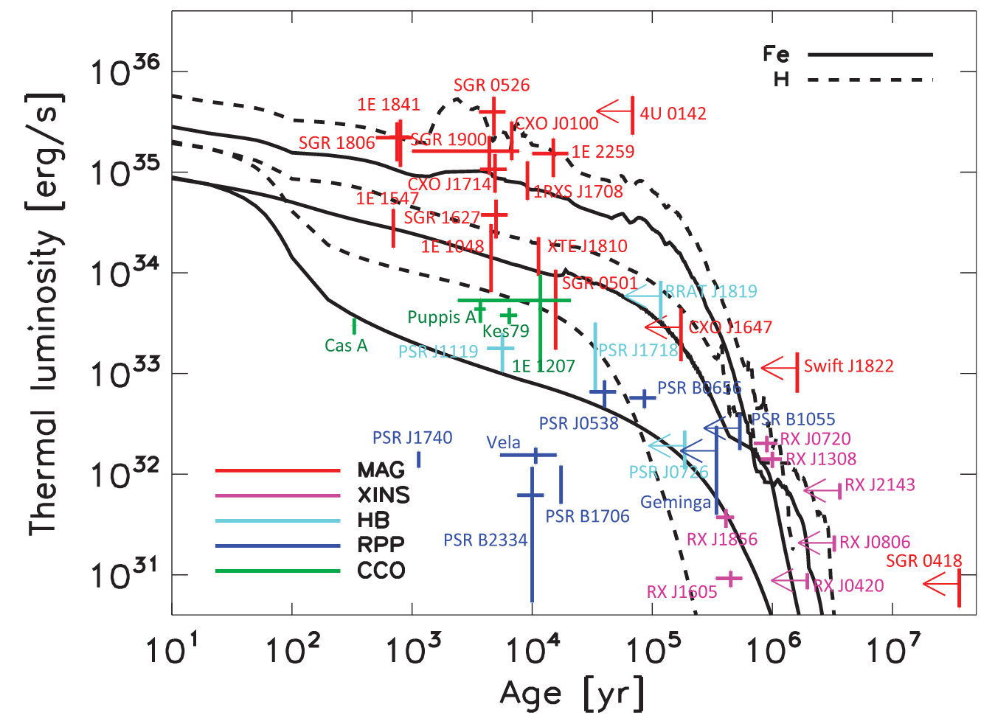
Implications for magnetar heating problem
“Magnetar heating problem”: magnetars hotter than other NS as inferred from higher X-ray luminosities
Explanations:
Light element envelope (Viganò et al. 2013)
Crustal heating (Kaminker et al. 2006, Beloborodov and Li 2016)
See also Chamel et al. 2021, Chamel and Fantina 2022
Viganò et al. 2013
Notes:
Light element envelope increases thermal conducti

Slide 44
Beloborodov and Li 2016 estimated that Ohmic dissipation in crust needs to exceed
to explain most luminous magnetars i.e., gradients
With dHvA oscillations, reach this with weaker fields e.g., with field!

Slide 45
Summary
Effect of SF-SC on thermal evolution seems well understood, but work remains on magnetic field evolution and joint magneto-thermal simulations
LQ-induced dHvA oscillations of magnetization capable of generating small-scale field features to enhance Joule heating, helping to resolve magnetar heating problem
Need to run joint magneto-thermal simulations to determine importance of dHvA oscillations

