Slide 1



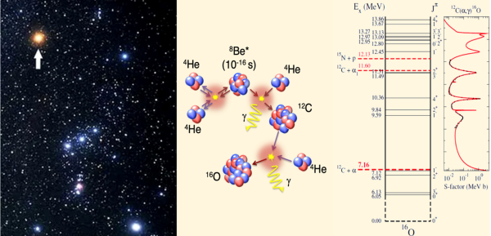
The Quantum Physics of Stars
August 17, 2026 August 21, 2026
Nuclear Clustering dynamics in real and imaginary time
Theodoros Depastas¹, Aldo Bonasera^{1,2}
1 Cyclotron Institute, Texas A&M University, College Station, Texas, USA
2 Laboratori Nazionali del Sud, INFN, Catania 95123, Italy

Slide 2
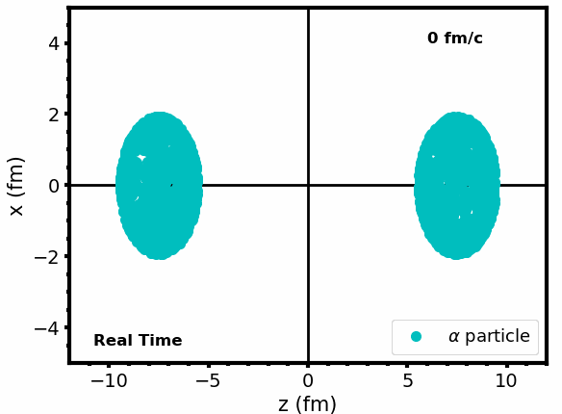
Introduction
Microscopic calculations: Vlasov dynamics in imaginary times.
Future directions-Constrained Molecular Dynamics (CoMD)
Hybrid Alpha Cluster model (T.Depastas).
Macroscopic calculations: Neck model in imaginary times (S. Sun).
Experimental challenges: pair production in sub barrier fusion reactions (T. Settlemyre)
Conclusions

Slide 3
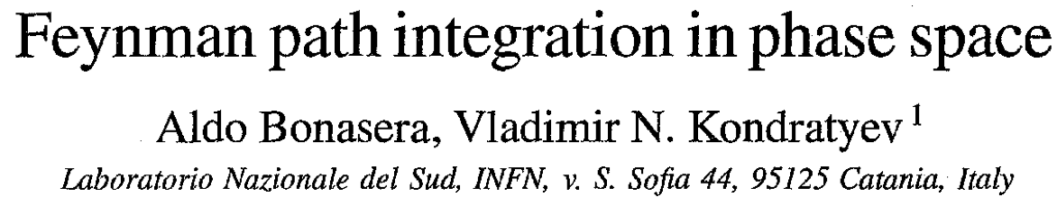

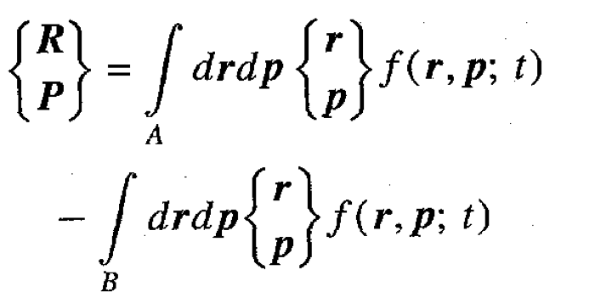
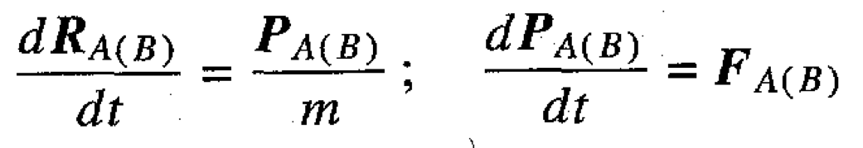
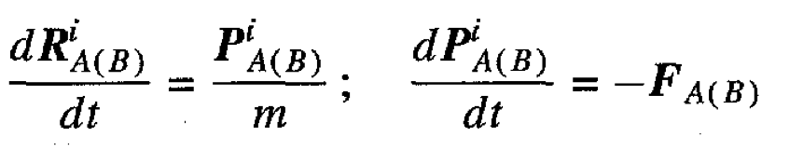
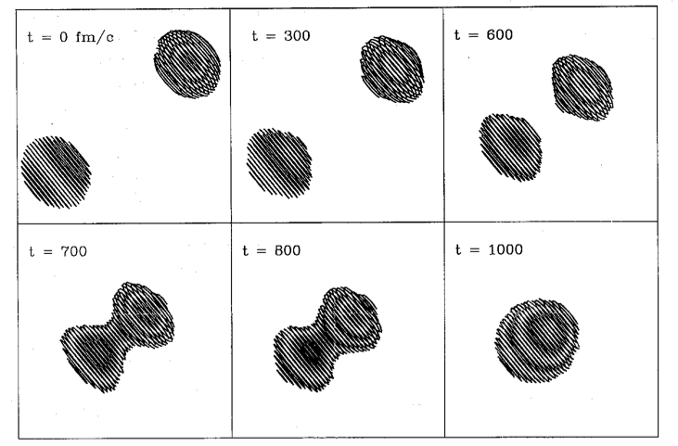
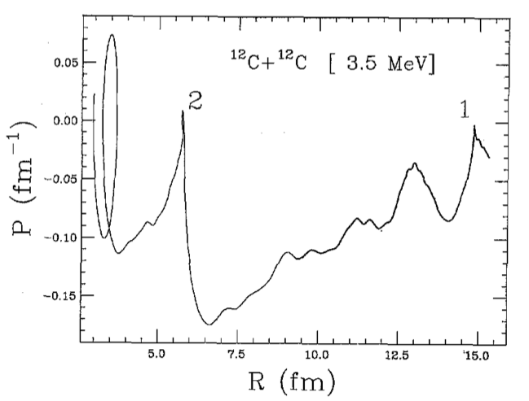
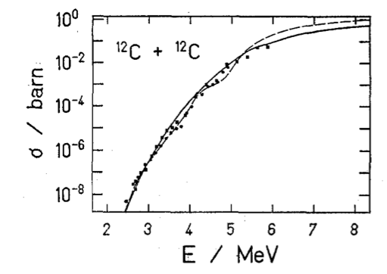

Phys.Rev.Lett.78(1997)187
Solve the Vlasov equation in imaginary time. Define collective variables R&P
in imaginary time t—>it

Slide 4
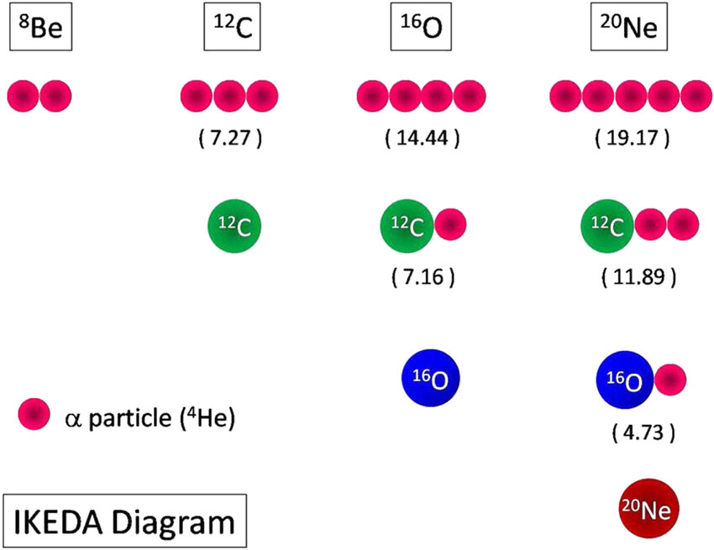
Introduction: Nuclear Clustering
2
Clusterization: feature of Many-Body systems (galaxies, atoms → molecules, quarks →hadrons,…)
D. Jenkins, J. Phys. G: Nucl. Part. Phys. 43 (2016) 024003
Nuclear ground states → homogenous Fermionic fluids
Above decay threshold states → “Nuclear Molecules” → Altered Dynamics
α-particles: very stable (π: 1s² ; ν: 1s² closed shells and no g.s. Pauli-correlations)
Hafstad and Teller (1938), Ikeda (1968) → appearance as clusters in A=4N nuclei
Prominent effects in low energy dynamics (Hoyle ¹²C state, BECs, rotational bands, α-conjugate SNM, …)
L. R. Hafstad, E. Teller, Phys. Rev. 54 (9 1938), pp. 681–692; K. Ikeda, N. Takigawa, H Horiuchi, Progress of Theoretical Physics Supplement E68 (1968).

Slide 5
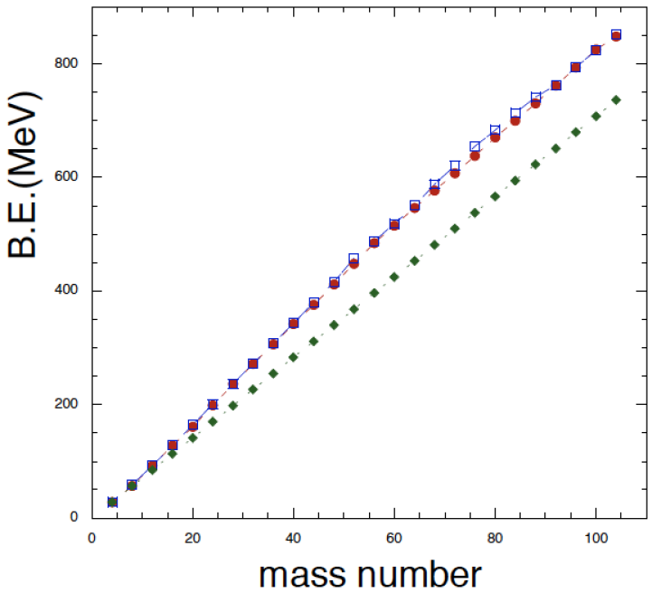

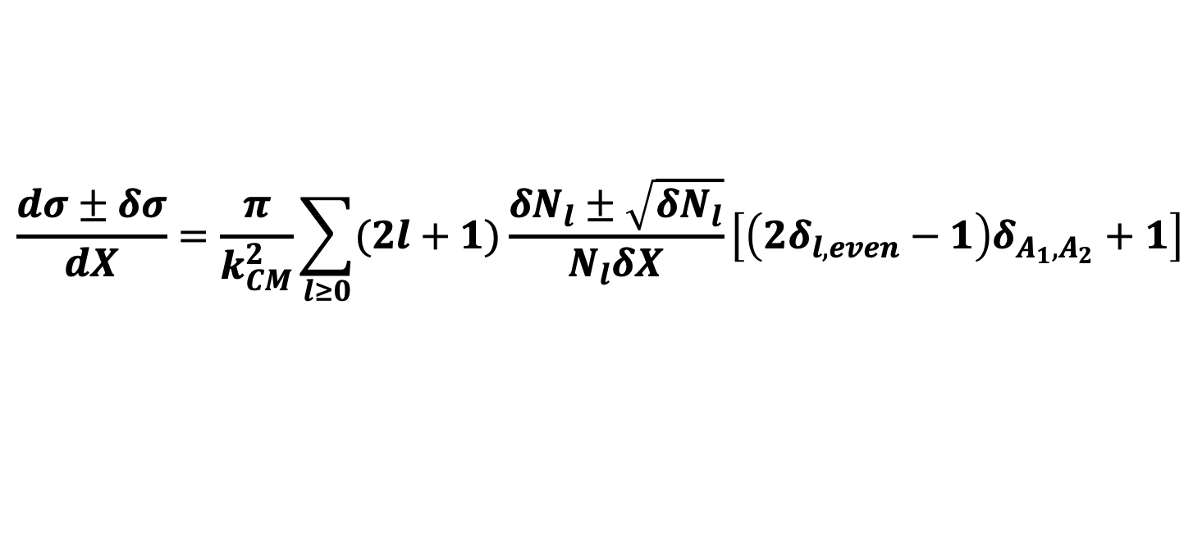
The Hybrid α-Clustering (HαC) Model
4
Semi-classical molecular dynamics model
H. Zheng, A. Bonasera, Symmetry 13, 1777 (2021)
α-particles as fundamental d.o.f.
Microscopic Hamiltonian:
Nuclear (Bass) Potential
$$𝓗=T+E_{F}+V_{B}+V_{c}$$
Coulomb Potential
Kinetic Energy
Effective Fermi Energy
Ground States: B.E. reproduced for 8<A<100, ⁸Be overbound
Quantization of impact parameter → $l=k_{CM}b$
Above Barrier Cross Section → Collection of > 1M events
HαC ; Experimental ; BE = N_{α} BE_{α}
Identical Boson symmetrization factor
$$\frac{dσ±δσ}{dX}=\frac{π}{k_{CM}^{2}}\sum_{l≥0}{(2l+1)\frac{δN_{l}±\sqrt{δN_{l}}}{N_{l}δX}}\left[\left(2δ_{l,even}−1\right)δ_{A_{1},A_{2}}+1\right]$$
H. Zheng, A. Bonasera, Symmetry 13, 1777 (2021); T. Depastas, A. Bonasera, J. Natowitz, Phys. Rev. C 112, 014614 (2025).

Slide 6
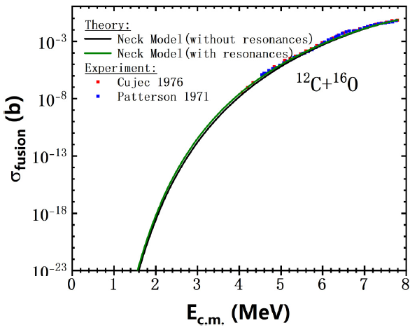
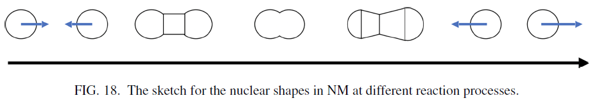
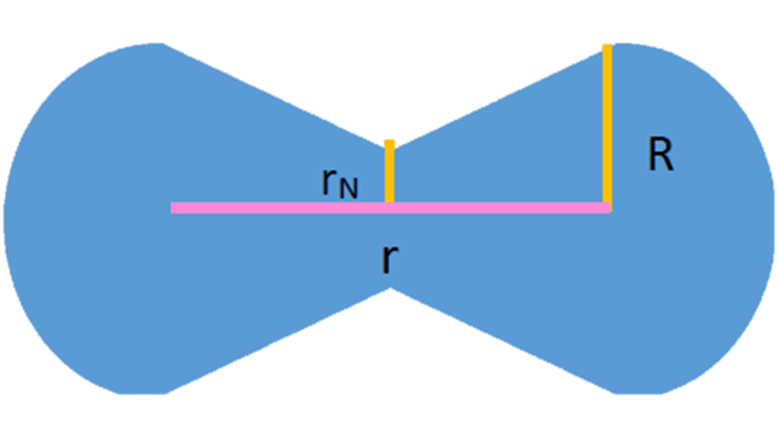
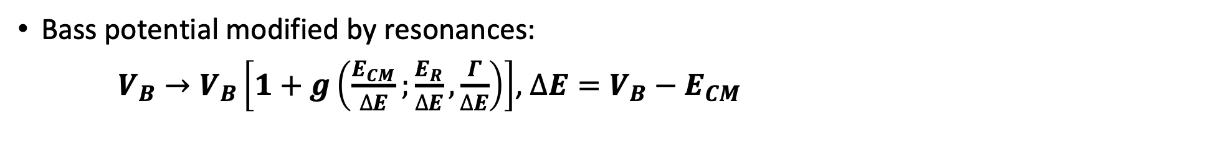
The Neck Model (NM)
5
Classical limit of Wigner-transformed TDHF, i.e., Mean-field
Macroscopic dynamics, d.o.f. → neck radius & internuclear distance
Interaction: Bass potential, Coulomb, nucleon exchange (friction)
Neck radius determined by Volume conservation
Bass potential modified by resonances:
$V_{B}→V_{B}\left[1+g\left(\frac{E_{CM}}{∆E};\frac{E_{R}}{∆E},\frac{Γ}{∆E}\right)\right]$, $∆E=V_{B}−E_{CM}$
A. Bonasera and J.B. Natowitz. Phys Rev C, 102, 061602(R), 2020; A. Bonasera, G. Bertsch, E. El-Sayed, Phys. Lett. B 141 (1984); S.T. Sun, T. Depastas, H. Zheng, A. Bonasera, Phys. Rev. C 111, 014602 (2025).

Slide 7
Neck model in imaginary times
The probability of fusion for the l th-partial wave is given by
Tl =1/(1 + exp{2A}),
To take into account resonances modify the Bass potential as:
PHYSICAL REVIEW C 111, 014602 (2025)

Slide 8
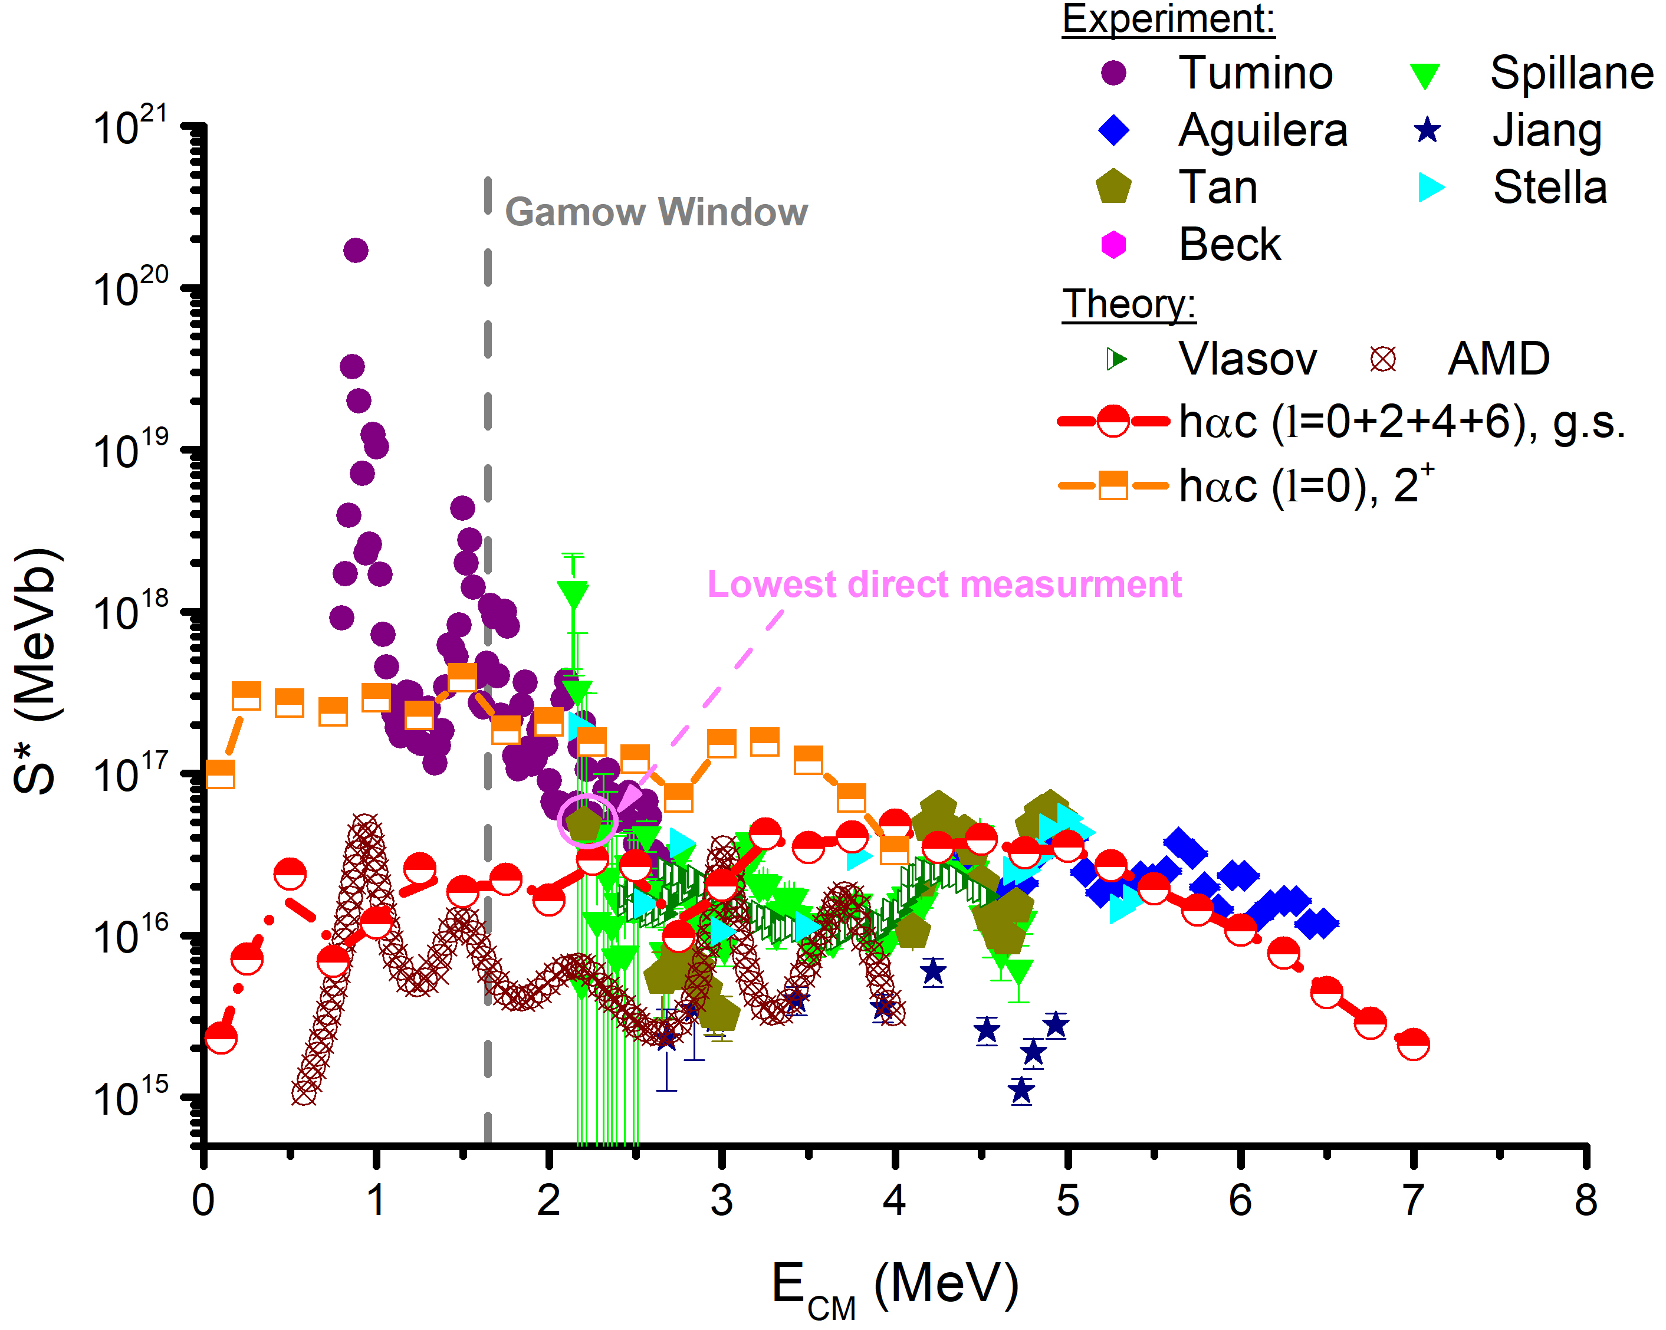
Astrophysical Factors: HαC & NM Results
10
Trojan Horse Method (THM): Low energy measurements
HαC model: Preliminary study of 2⁺ excited state fusion → Possible J=2 mixtures in THM study
HαC model: S*(E) ~ 10¹⁵⁻¹⁷ MeVb, smooth function; Agreement with Vlasov & experimental data for E>2.5 MeV
HαC model → semiclassical, i.e., no CN levels
Mean Field (Vlasov) Calculations
T. Depastas, S.T. Sun, H. Zheng, A. Bonasera, Phys Rev C 108, 035806 (2023); A. Tumino et al., Nature 557 (2018) 687–690.

Slide 9
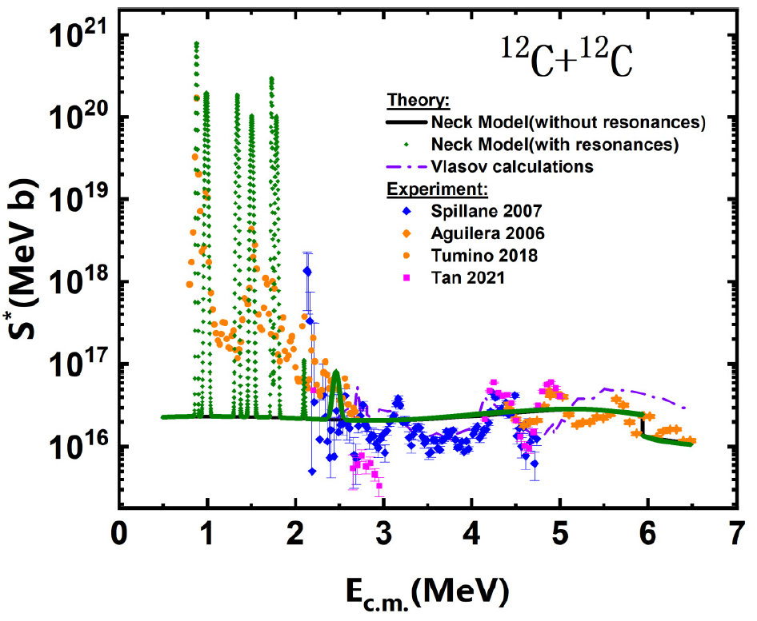
Astrophysical Factors: HαC & NM Results
11
NM: Reproduction of CN levels + negligible GQR contribution; Baseline agreement with HαC
(less fluctuations → Mean field model)
S.T. Sun, T. Depastas, H. Zheng, A. Bonasera, Phys. Rev. C 111, 014602 (2025); A. Bonasera, J.B. Natowitz. Phys Rev C, 102, 061602(R), 2020.

Slide 11
Compound Nucleus Model
Phys. Lett. B 860 (2025) 139180
E*-Independent
T. Depastas, S.T. Sun, H.B. He, H. Zheng and A. Bonasera , EPJ Web of Conferences 304, 02004 (2024).

Slide 12
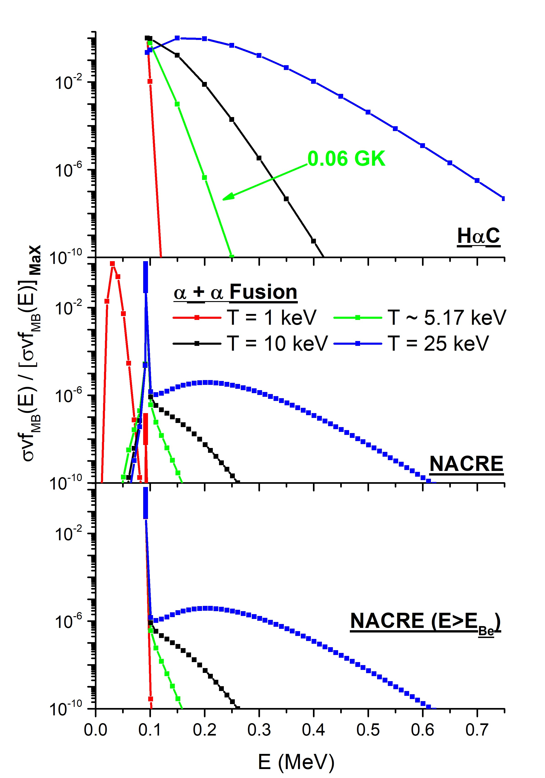
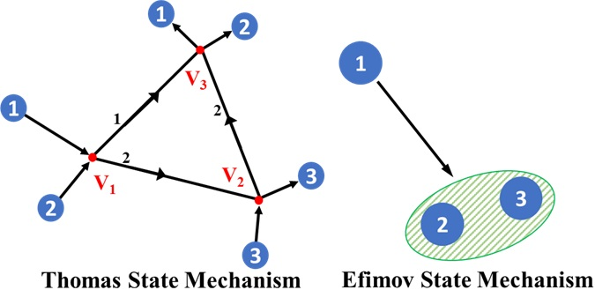
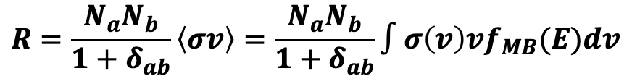
Preliminary Results: 3α Reaction
V
The three α-particles have the same energy at low temperatures → Thomas Mechanism (Zheng & Bonasera)
$$R=\frac{N_{a}N_{b}}{1+δ_{ab}}\left\langle σv\right\rangle =\frac{N_{a}N_{b}}{1+δ_{ab}}∫σ\left(v\right)vf_{MB}(E)dv$$
T.D.&A.B. Phys. Lett. B 875 (2026) 140289

Slide 13
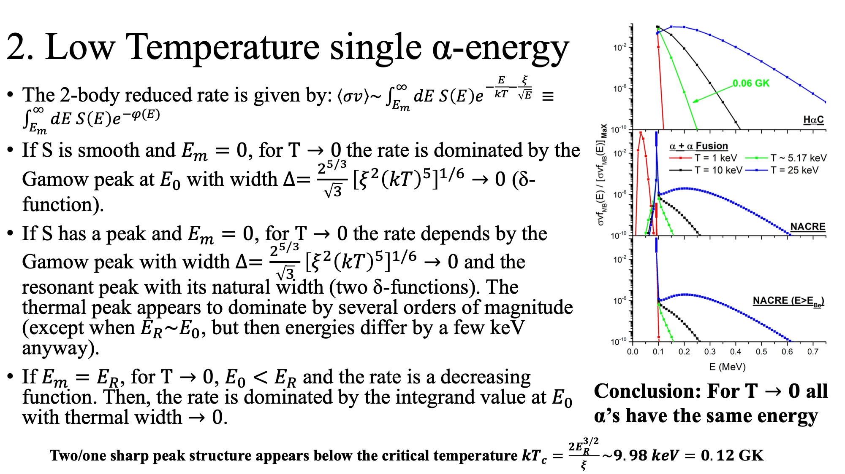

Slide 21
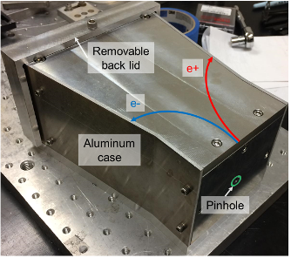
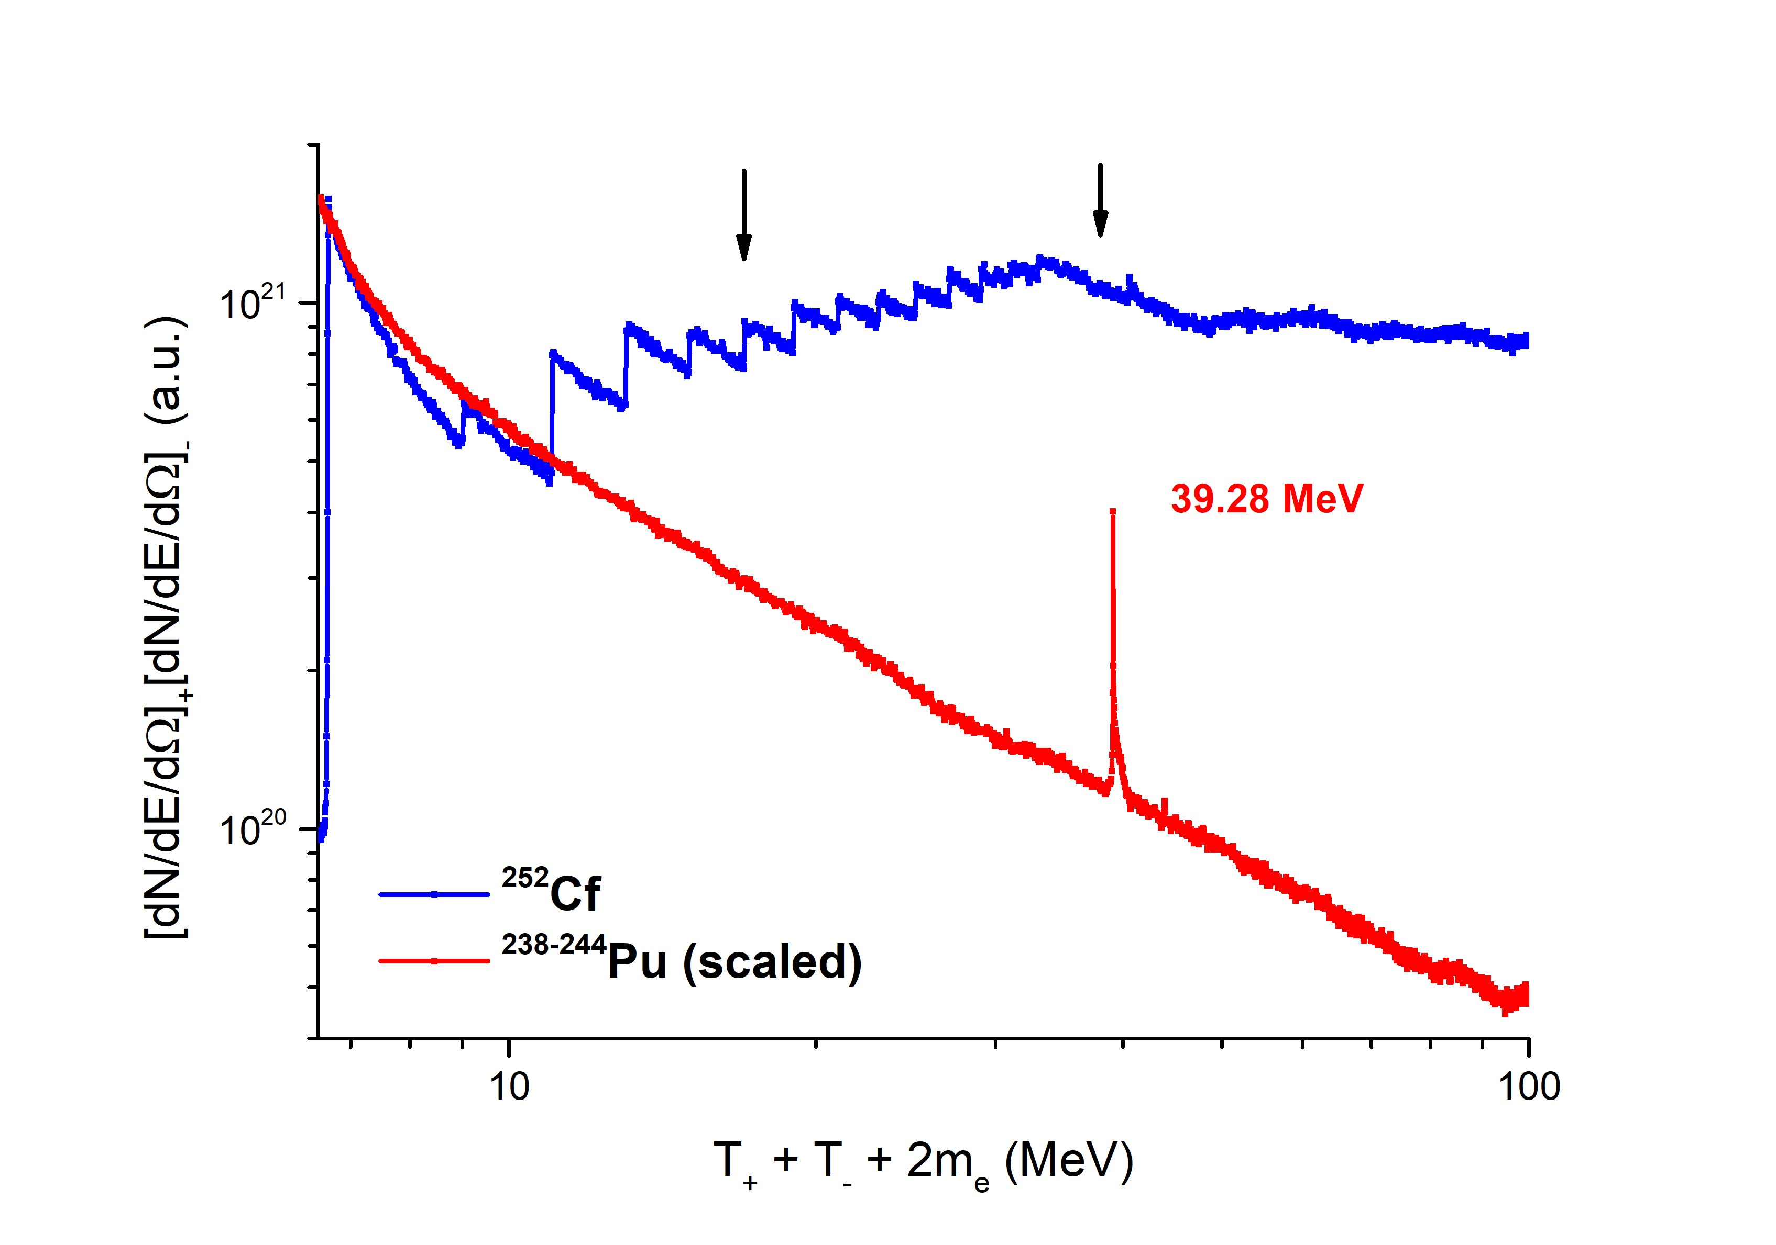
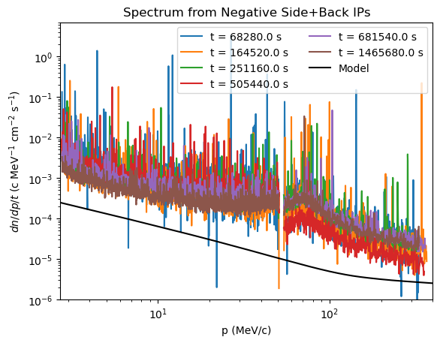
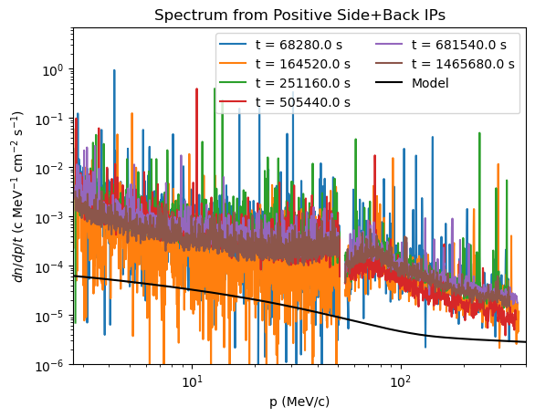
Spontaneous Fission
Preliminary
T.Depastas, A.Willis, J.Mabiala, M.Rodrigues , H. Quevedo and A.B.

Slide 22
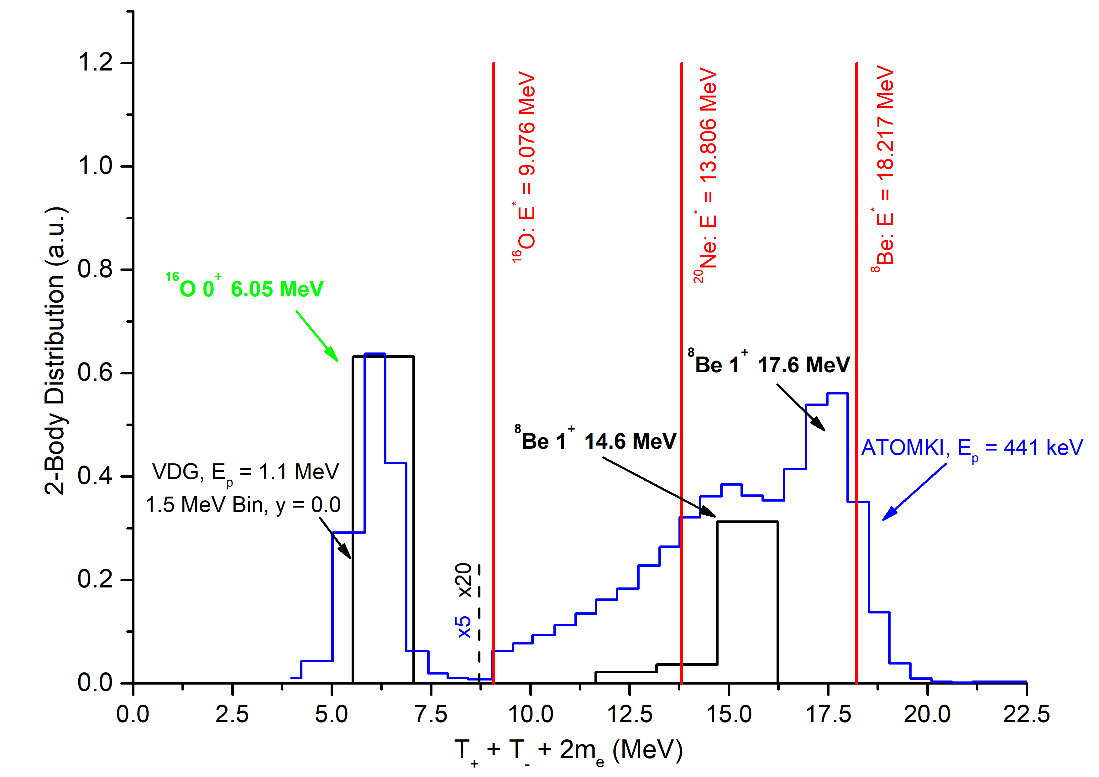
p+LiF 1.1MeV @0 degrees in vacuum VDG in Prague
Preliminary

Slide 23
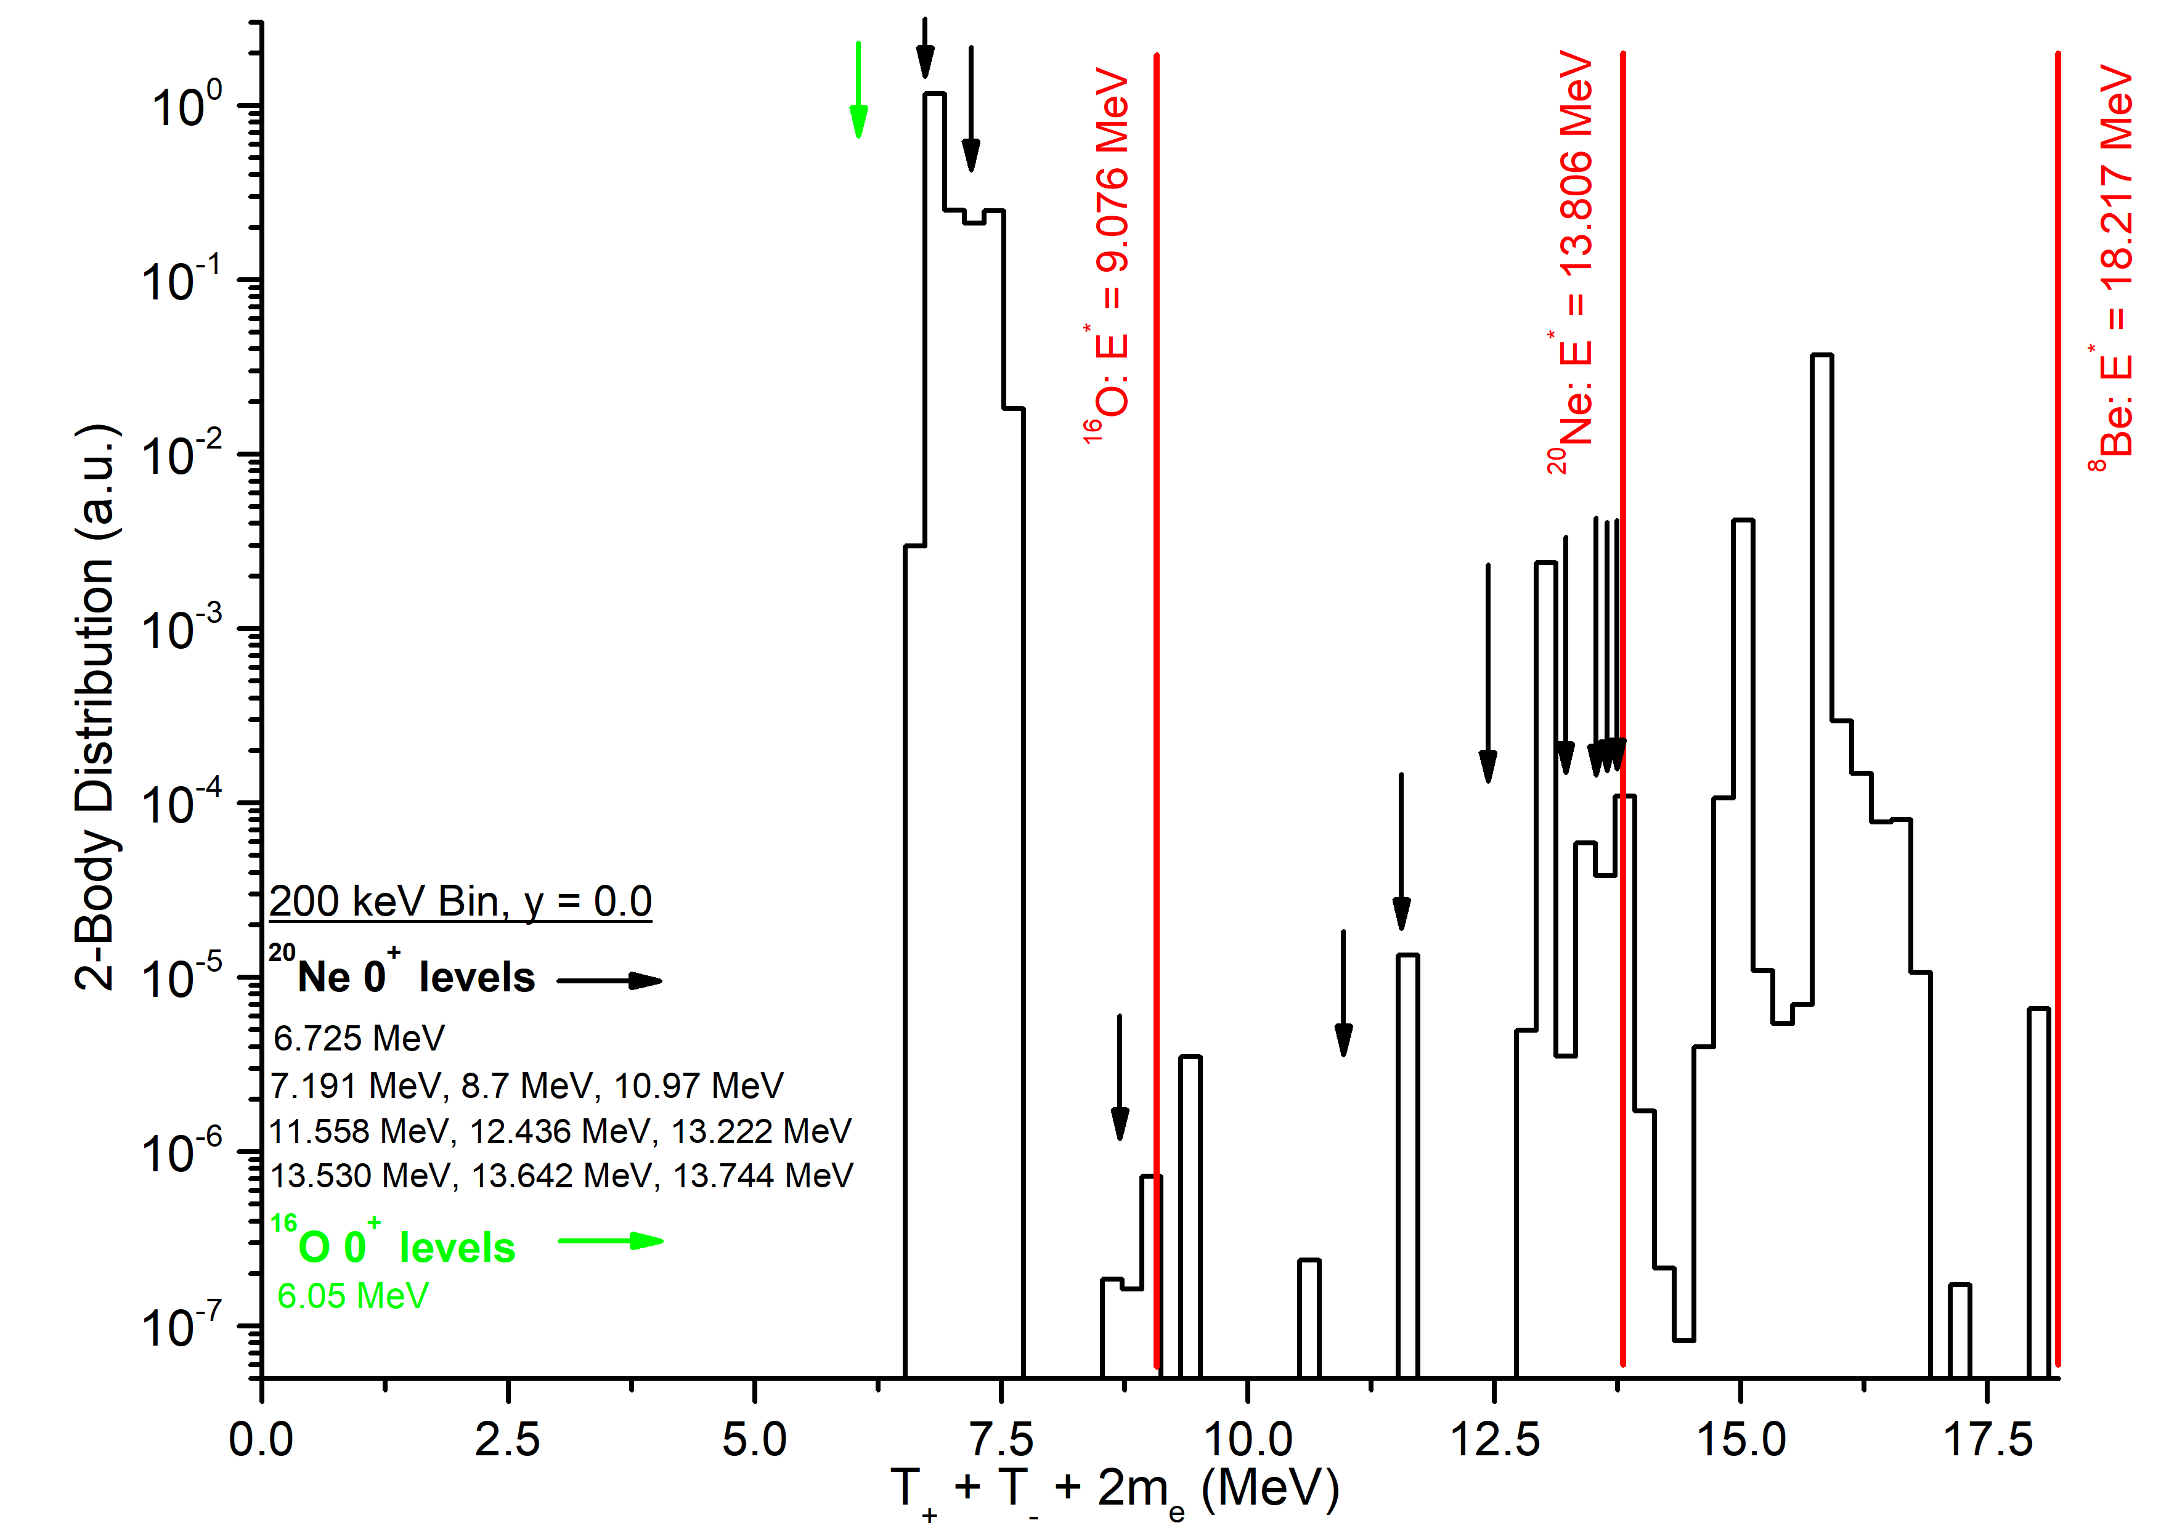
Preliminary

Slide 24
Conclusions:
  Real + Imaginary Time study of α-cluster dynamics with HαC and Neck models.
Theoretical description of Helium&Carbon Burning: S*-factors (analytical & numerical), Sub-barrier resonances, reaction rates and 2⁺₁ + 0⁺₁ fusion.
3. Pair production in heavy and superheavy nuclei plus other systems including cosmic.
The End
Thank for your attention !
ACKNOWLEDGEMENTS
This work was supported by the United States Department of Energy under Grant #DE-FG02-93ER40773.

